Slide 1


MOS capacitor –
MOSFET transistor –
MOS inverterS
Prof. Philippe LORENZINI
Polytech-Nice Sophia

Slide 2
Outline
Metal Oxyde Semiconductor Structure
MOS Transistor
MOS Inverters
  NMOS
  CMOS

Slide 3
Two definitions (only 2!)
  Work Function (Travail de sortie) : this is the energy we have to give to an electron to extract it of metal without kinetic energy. It reaches the "vacuum level". Work function is the energy difference between the vacuum level and the highest occupied energy level, ie the Fermi level.
  Electron Affinity (Affinité électronique ) : it’s the difference between the vacuum level and the bottom of the conduction band. It’s only defined for SC and not for Metal.
  Unity for both of them: eV (electron volt)

Slide 4
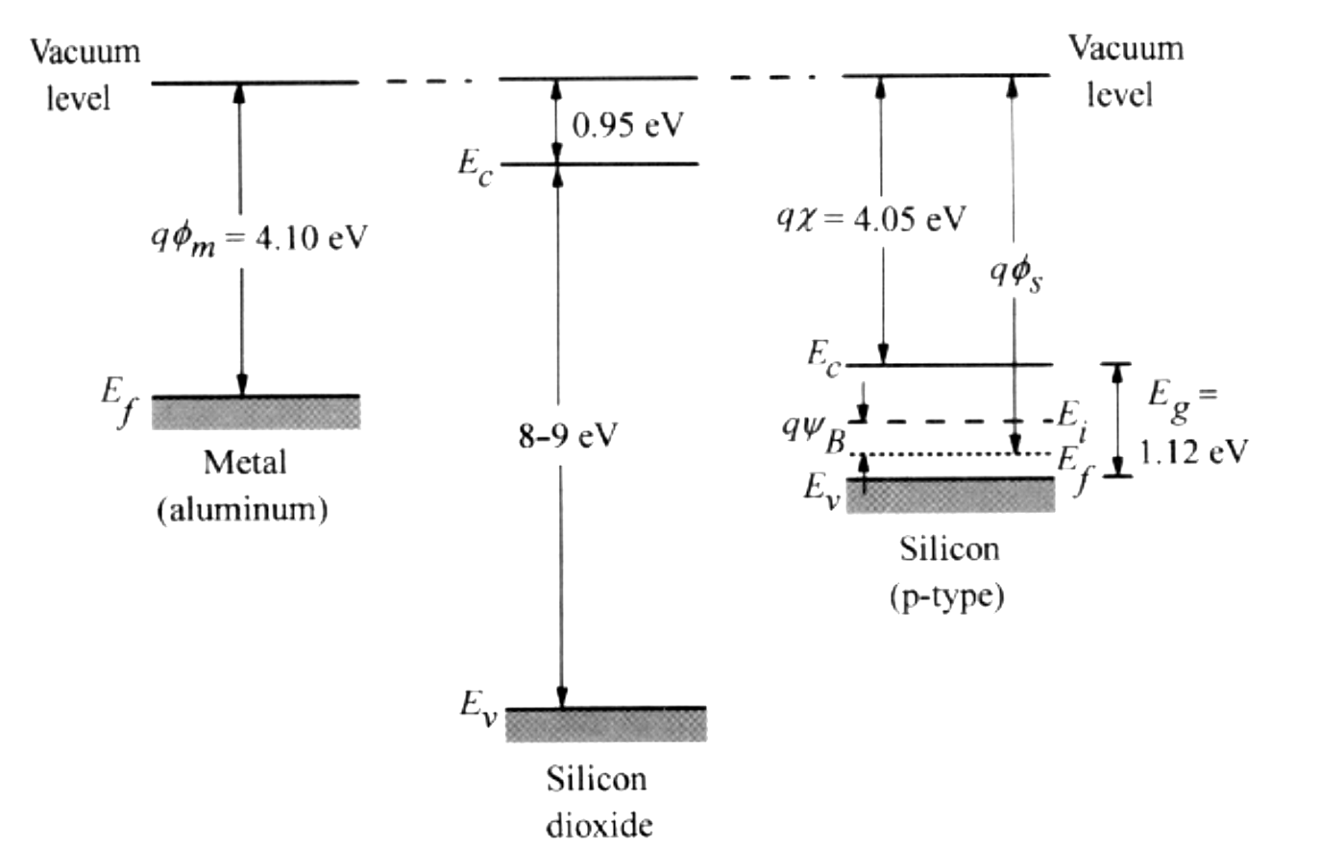
Metal Oxyde Semiconductor Structure
Energy band diagram of the three components of a MOS system
MOS capacitor

Slide 5
Field Effect Transistor
The field effect is the variation of the conductance of a channel in a semiconductor by the application of an electric field

Slide 6
Equilibrium of MOS structure
Metal
SC(n)
Metal
SC(n)
E_{C}
eVbi
E_{F}
E_{C}
E_{F}
E_{F}
E_{F}
E_{V}
E_{V}
dx
Independant system
Equilibrium state

Slide 7
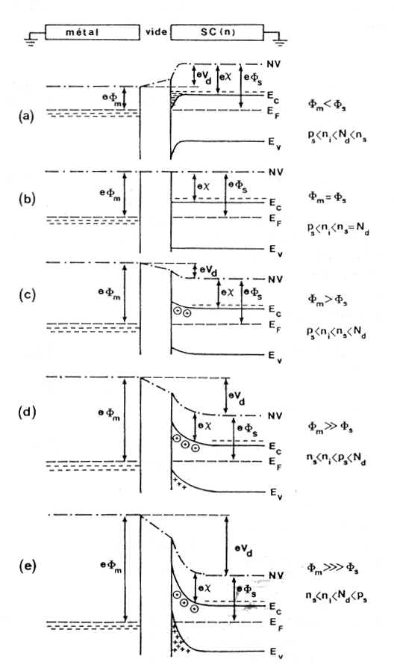
The five regimes : a function of work function
Ox
Accumulation
Flat band
Desertion / depletion
Weak inversion
Strong inversion

Slide 8
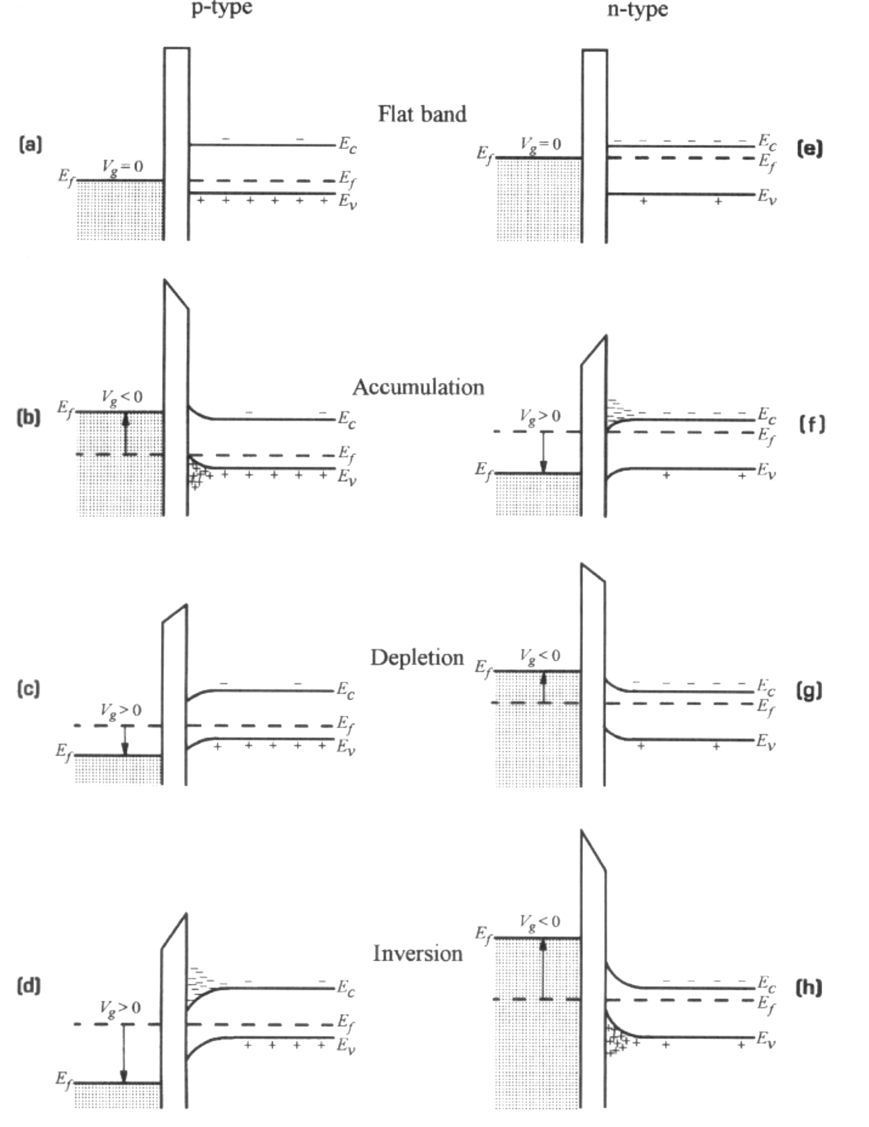
Energy band diagram for ideal n and p type MOS capacitors under different bias conditions

Slide 9
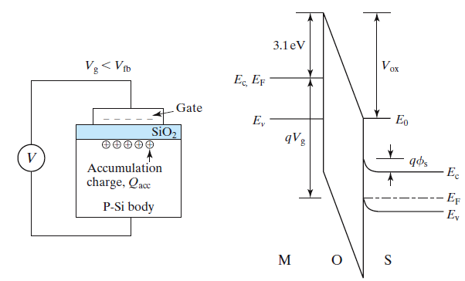
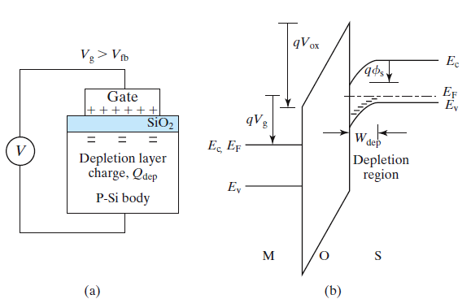
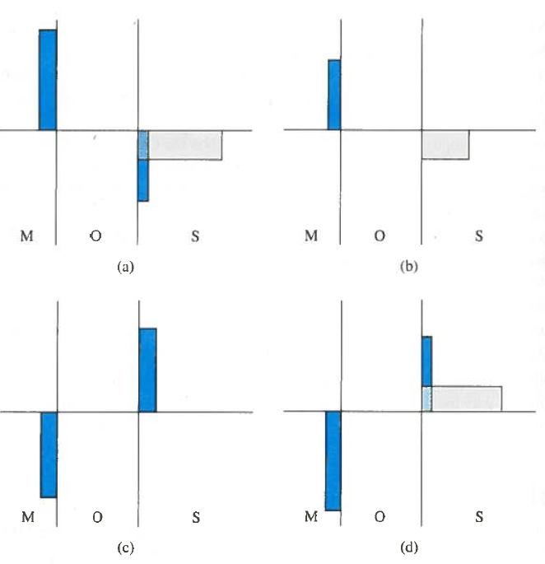
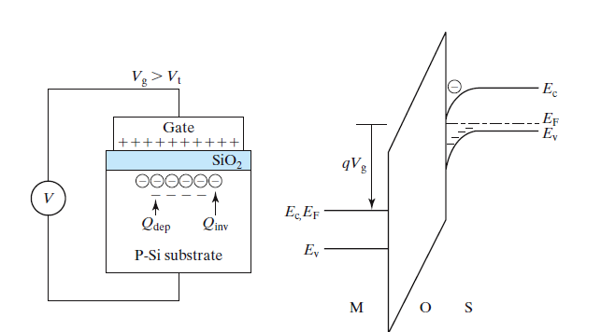

Slide 10
Field, potential and charges in Silicon
We suppose we deal with a p type semiconductor:
warning: in few books, absolute value is not present!!!!

Slide 11
Field, potential and charges in Silicon (p-type)
Poisson’s Equation:
Charge density

Slide 12
Field, potential and charges in Silicon

Slide 13
Field, Potential and Charges in Silicon
We calculate the integral from bulk to a point x in SC
M
O
S
V(x=« bulk »)=0 et
V_{g}
And the Electric Field is given by:

Slide 14
Field, potential and charges in Silicon
With the Debye length:
If we use the Gauss’s theorem:

Slide 15
Field, potential and charges in Silicon
With the Debye length:
If we use the Gauss’s theorem:
E=Ex
E=-Es
Qsc
E=0
X=0

Slide 16
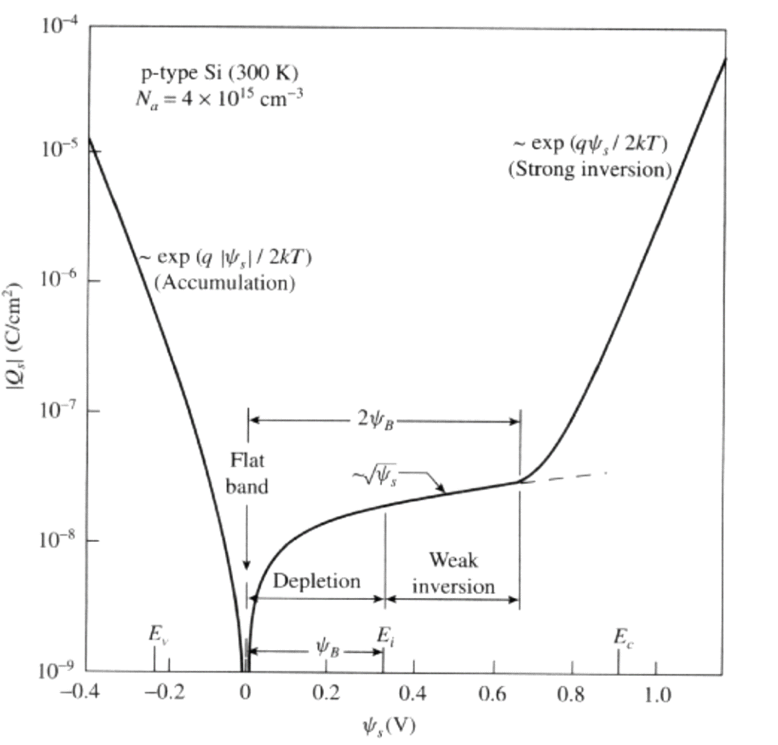
Allways negligible (p type)
Field, potential and charges in Silicon
For V_{s} (and so V_{g}) negative
(accumulation)
For V_{s} (and V_{g}) positive but
less than 2Φ_{fi}
(depletion – weak inversion)
For V_{s} (and Vg) > 2Φ_{fi}
(strong inversion)

Slide 17
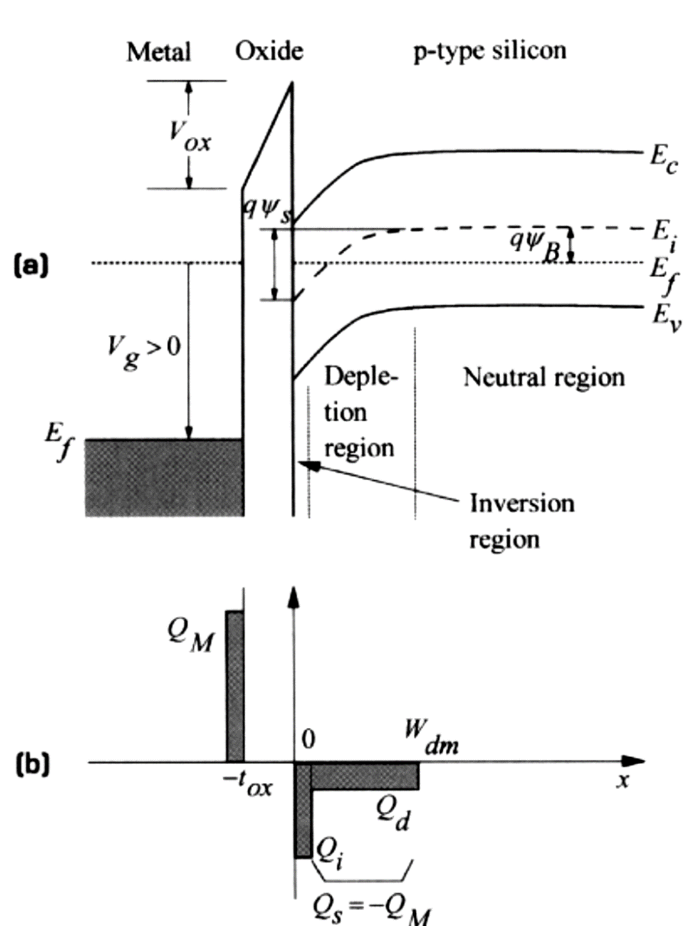
Weak / Strong Inversion
eΦ_{FI}
  n_{s}=p₀=N_{A}
This condition will define a very important parameter of the struture: the threshold voltage or the required gate voltage to put the transistor in strong inversion regime

Slide 18
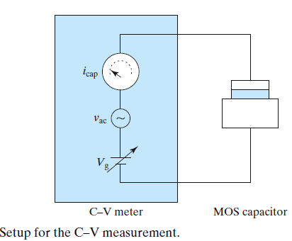
Measurement of capacitance in Ideal MOS Structure
The C-V curve is usually measured with a CV meter:
We apply a DC bias voltage Vg + small sinusoidal signal (100 Hz to 10 MHz)
We measure the capacitive current with an AC meter (90 degree phase shift) => i_{cap}/v_{ac} =ωC

Slide 19
Measurement of capacitance in Ideal MOS Structure
When a voltage Vg is applied on the MOS Gate, part of it appears as a potential drop across oxide and the rest of it appears as a band bending Vs in silicon:
SC is grounded,
so V_{SC}=V_{S}
V(X)
M
O
S
V_{g}
V_{OX}
V_{ox}
V_{SC}
V_{G}
V_{S}
Oxide and Silicon have capacitor behavior
-t_{OX}
0
X

Slide 20
Measurement of capacitance in Ideal MOS Structure
Oxide capacitance: as a parallel-plate capacitor
We can also write :

Slide 21
Measurement of capacitance in Ideal MOS Structure
Semiconductor (silicon) capacitance

Slide 22
Measurement of capacitance in Ideal MOS Structure
M
O
S
V_{g}
Global capacitance of the structure:
If we combine the 3 relations above :
V_{ox}
V_{SC}

Slide 23
Measurement of capacitance in Ideal MOS Structure
Total charge Q_{SC} depends on different regimes
⬄ 2 types of charges, fixed and mobile/free:
Semiconductor capacitance can be written as:

Slide 24
Measurement of capacitance in Ideal MOS Structure
Total charge in SC depends on different regimes
⬄ 2 types of charges, fixed and mobile/free:
Semiconductor capacitance can be written as:

Slide 25
Measurement of capacitance in Ideal MOS Structure
Summary: MOS capacitor is equivalent :
  of 2 capacitors connected in serie, C_{OX} and C_{SC}
  C_{SC} is equivalent of two capacitors
  - the two are variable and be view as 2 capacitors in //
C_{ox}
C_{ox}
C_{sc}
C_{s}
C_{dep}
Conclusion: the total capacitance of MOS structure is function of bias conditions or operating regime through C_{SC}

Slide 26
Capacitance of MOS structure
Accumulation Regime: V_{S}<0 ie V_{G}<0

Slide 27
Capacitance of MOS structure
Accumulation Regime: V_{S}<0 ie V_{G}<0
C_{ox}
C_{sc}

Slide 28
Capacitance of MOS structure
Accumulation Regime: V_{S}<0 ie V_{G}<0
kT=26 meV, in accumulation regime V_{S} is around -0,3 V to -0,4 V, ⬄ as soon as V_{G}<-1 to -2 V, so we can simplify to:

Slide 29
Capacitance of MOS structure
Flat Band: V_{S} =0 V ie V_{G}=0 V
(warning : ideal structure!!!!!)
Analytical computing:
<< d_{ox}

Slide 30
Capacitance of MOS structure
Depletion regime and weak inversion
Insulator ε
W_{dep}

Slide 31
Capacitance of MOS structure
Depletion regime and weak inversion

Slide 32
Capacitance of MOS structure
Strong inversion

Slide 33
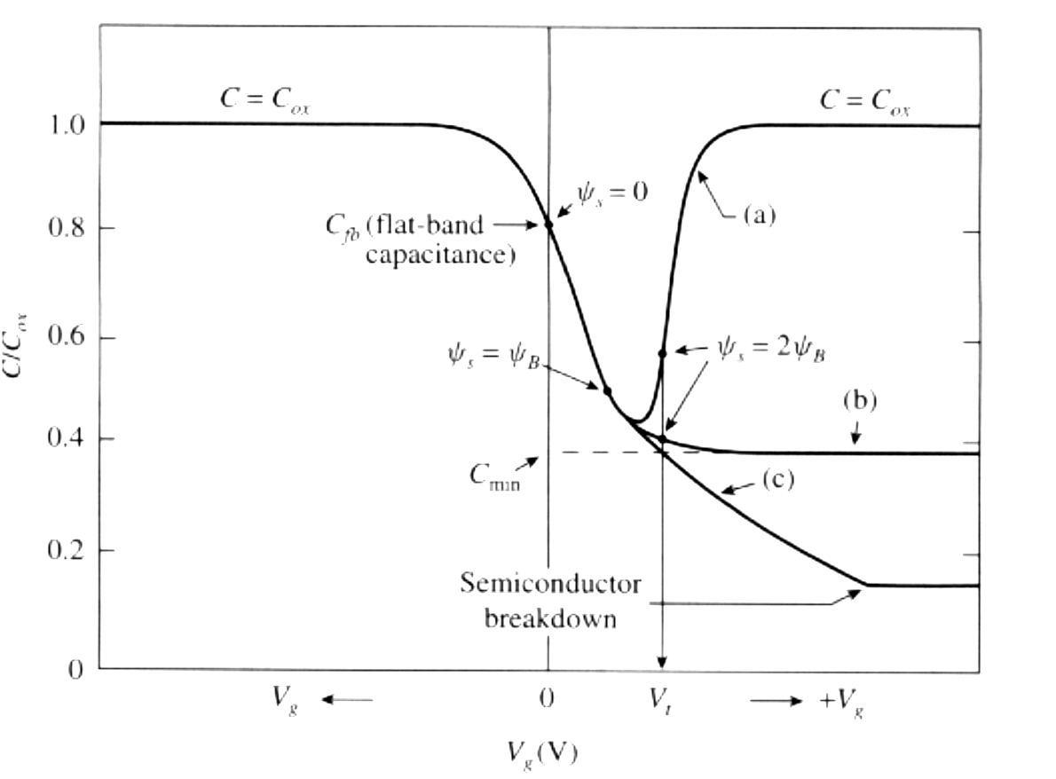
Capacitance of MOS structure
Strong inversion
accumulation
dep
???
p type SC
p type SC

Slide 34
Capacitance of MOS structure
Strong inversion:
Which mechanism governs the onset of strong inversion layer?
P type SC : we must create electrons at oxide/SC interface. Where they come from?
  From Metal : NO because oxide barrier
  From SC (neutral region) : NO minority carriers (e-)
Only one solution: thermal (or optical) generation

Slide 35
Capacitance of MOS structure
Strong inversion:
  Thermal generation?
    #1 :In the space charge + dissipation of charge by electric field
    #2 : In the neutral region
  First mechanism dominates but it’s a slow one.

Slide 36
Capacitance of MOS structure
Strong inversion
  Which Delay time to create strong inversion layer ?
Shockley-Read equation
Strong inversion limit: n_{S} = N_{A}
Si:
n_{i}=10¹⁰ cm⁻³
N_{A}=10¹⁵ cm⁻³ τ_{s}=1s !!
τ_{m}=10⁻⁵ s
More realistics

Slide 37
Capacitance of MOS structure
When we measure C(V) , results depend on YES or NO, we give enough time to create this layer
  YES: we measure capacitance du to inversion layer
  NO : Depletion layer preserves the neutrality of the system with an increase of its width . The limit is the breakdown of the semiconductor
Results are frequency dependant

Slide 38
Capacitance of MOS structure:
strong inversion
3 cases :
Low frequency
+
Slow ramp Vg
High frequency
+
High ramp Vg
High frequency
+
Slow ramp Vg
Q
Q
Q
x
x
x

Slide 39
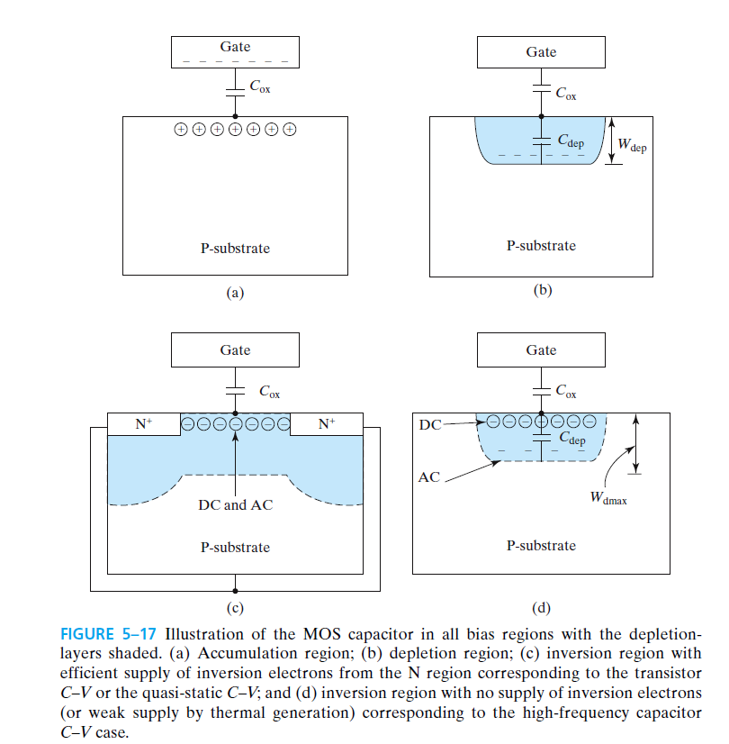
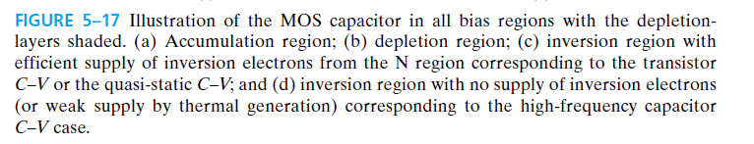

Slide 40
Capacitance of MOS structure: strong inversion
minimum capacitance (HF):
BF
HF

Slide 41
MOS capacitor : parasitic effects
2 factors modify « ideal » structure of MOS capacitor.
  The charges in oxide and/or charges at interface Oxide – SC.
  The difference between the work function of the Metal and the SC
Influence on the threshold voltage V_{T} of the structure.

Slide 42
MOS capacitor :oxide charge
Distribution of charges in the oxide :
  Mobile ionic charges
  Oxide traped charges
  Fixed oxide charges
  Traped charges at Si-SiO₂ interface
K⁺
Na⁺
Ionic mobiles
SiO₂
- - - -
traped
+ + + +
+ + + + +
SiO_{x}
x x x x
Si
Depending on their position in the oxide, the charges will influence more or less on the electron population below the gate.

Slide 43
MOS capacitor :oxide charge
Effect of a sheet charge of a real density Q within the oxide layer of an MOS capacitor:
Q
V_{g}=0V
ρ(x)
Oxide charges are compensated with charges in Metal AND SC.
Metal
Oxide
Si
0
x₁
x
V_{g}=V_{fb}
Q
ρ(x)
If Vg=Vfb, charges in SC must be zero. Only Metal « DO the job »
d_{ox}
x
-Q

Slide 44
MOS capacitor :oxide charge
The effect is maximum when the charges are located at the interface oxide - SC, ie Q_{ox}=Q_{SS} (and no effect if Q_{ox} close to Metal)
It is a common practice to define an equivalent oxide charge per unit area Q_{ox} located at the oxide – silicon interface (named Q_{SS}):

Slide 45
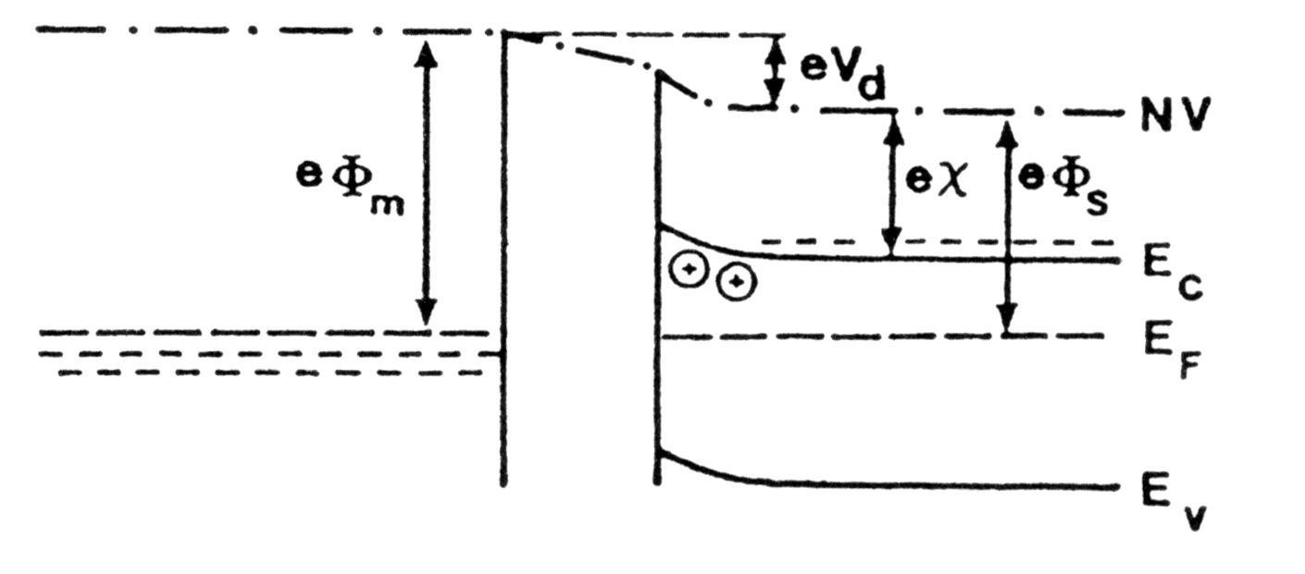
Work function difference
Work function difference ⬄ non zero oxide field.
  Even when V_{g} = 0 V, structure show a band bending
eχ_{ι}
Depletion zone
A gate voltage must be applied to restore the flat band condition ⬄ V_{FB} = φ_{M} – φ_{S} = φ_{MS} : this voltage is called Flat Band voltage V_{FB}

Slide 46
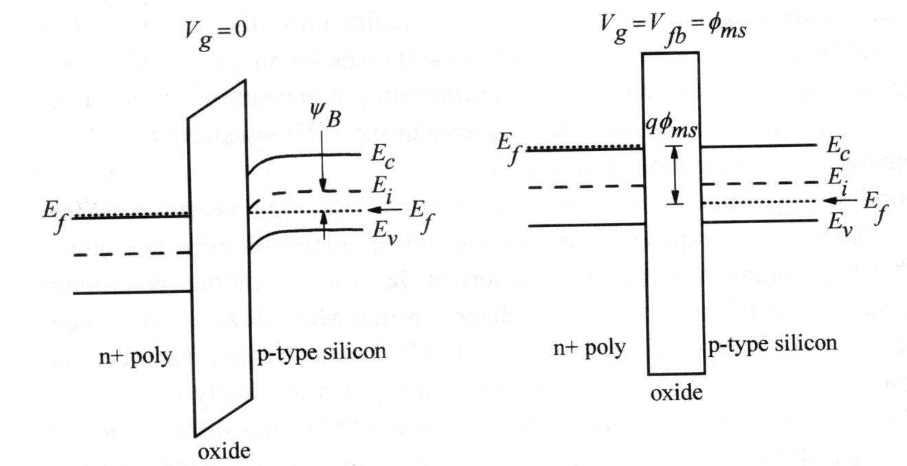
Work function difference
Work function difference.
  Example: polysilicon n⁺ gate on p-MOS

Slide 47
Non ideal MOS capacitor
Taking into account both Oxide charges and work-function difference, the global flat band voltage can be written as:
Warning: this is the voltage we have to apply on the gate to restore de flat band condition.

Slide 48
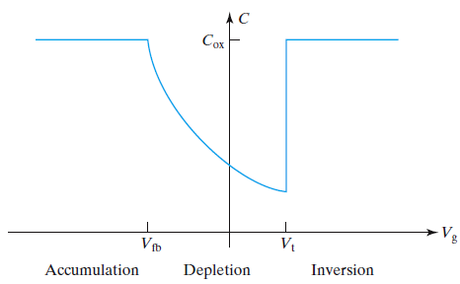
Capacitance of Non ideal MOS structure:
Imagine the depletion regime of the MOS capacitor (Qss=0)
We know that :
~

Slide 49
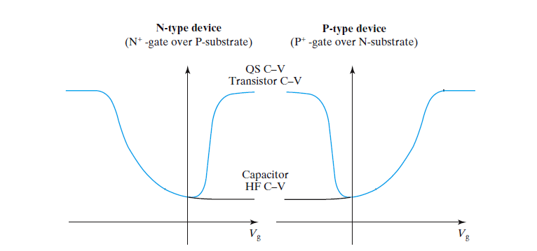
Capacitance of Non ideal MOS structure:
Imagine the depletion regime of the MOS capacitor (Qss=0)
We know that :
~

Slide 50
Threshold voltage
Key parameter for behavior understanding of transistor
Many definitions (same results!):
  n_{S} = N_{A}
  V_{s} = 2 φ_{fi}
  …

Slide 51
Threshold voltage
V_{T} is simply the applied gate voltage when the surface potential or band bending reaches 2Φ_{FI} and the silicon charge is equal to the bulk depletion charge for that potential
(from slide 17
and 48)
(we suppose here that no bias on the bulk is present ⬄ no body effect)
V(X)
V_{OX}
V_{T}
V_{S}=2Φ_{FI}
-t_{OX}
0
X

Slide 52
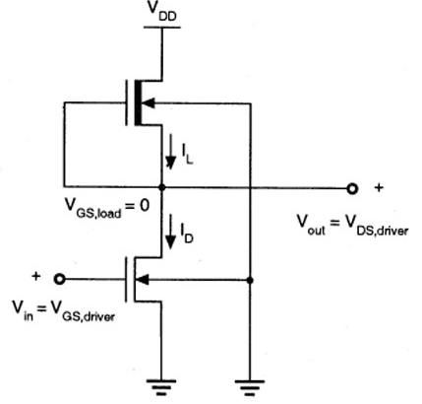
Threshold voltage
Substrate sensitivity - Body Effect
  In general the MOS devices have a common silicon substrate ⬄ substrate voltage is equal for all transistor.
  BUT when multiple NFETs (or PFETs) are connected in series in a circuit, they share a common body (the silicon substrate) but their sources do not have the same voltage. We must introduce a coefficient that accounts for this effect :γ

Slide 53
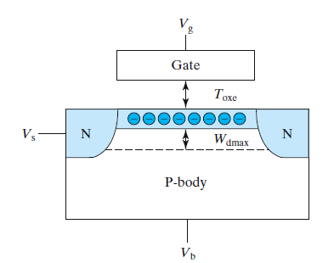
Threshold voltage
>0
>0
+++++++
+++++++
- - -
+ + +
=0
<0
One part of Gate voltage is no more used to create inversion layer but just to compensate the extra depletion width ⬄ V_{T} will increase

Slide 54
Threshold voltage
The new threshold voltage taking account the body effect can be written as:
The substrate sensitivity as:
Of course substrate bias have to be reverse to prevent current flow

Slide 55
Threshold voltage
1,8
-3
Na = 1E16 cm
-3
Na = 3E15 cm
1,6
T
1,4
Threshold voltage (V)
1,2
1,0
0,8
0
2
4
6
8
10
Substrate bias voltage
V
(V)
SB
The effect of (reverse) substrate bias is to widen the bulk depletion region and raise the threshold voltage:
The back contact acts as a back Gate
We can tune V_{T} !

Slide 56
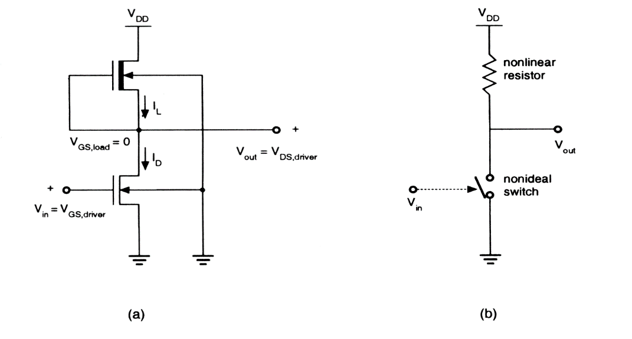
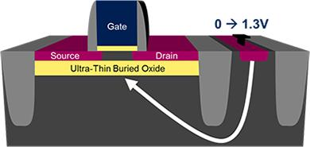
Threshold voltage : body effect
Drawback or advantage ?

Slide 57
MOS-FET transistor

Slide 58
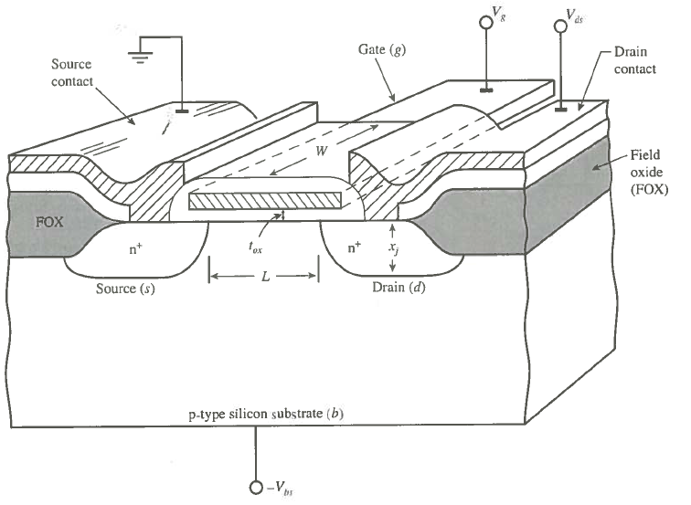
MOS-FET transistor

Slide 59

Graphical summary of the major processing steps in the formation of a MOSFET Transistor
http://www.youtube.com/watch?v=dR-Qtv-7uWI

Slide 60
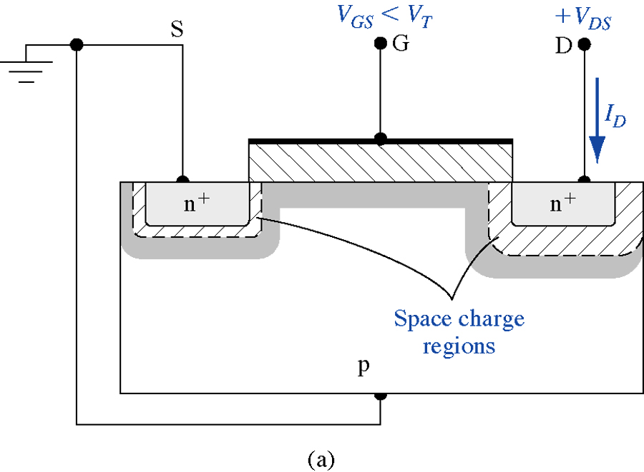
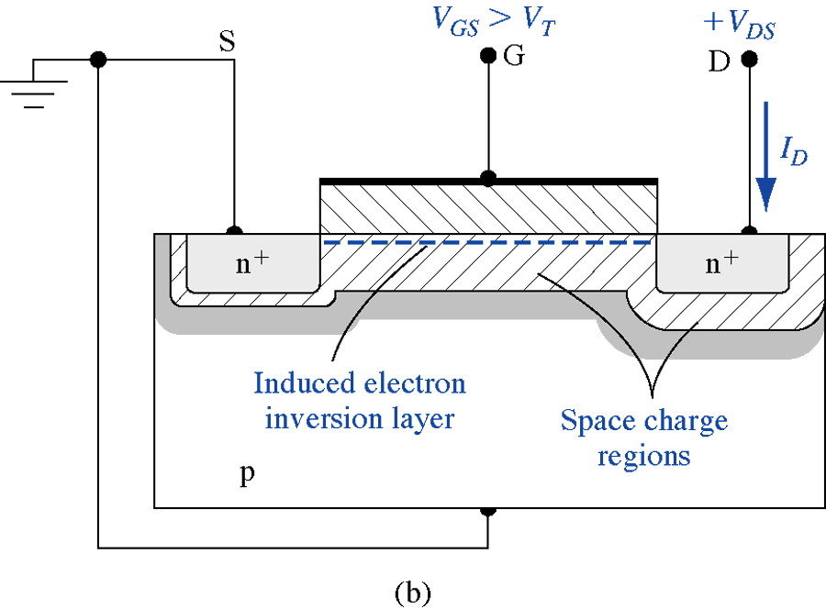
MOS-FET transistor
Stockage time ?

Slide 61
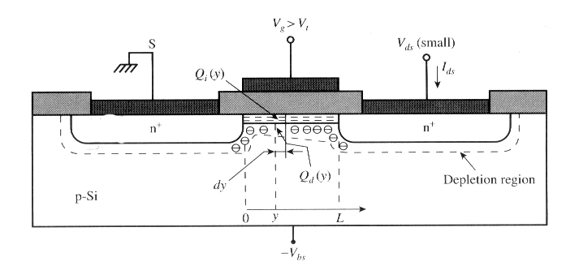
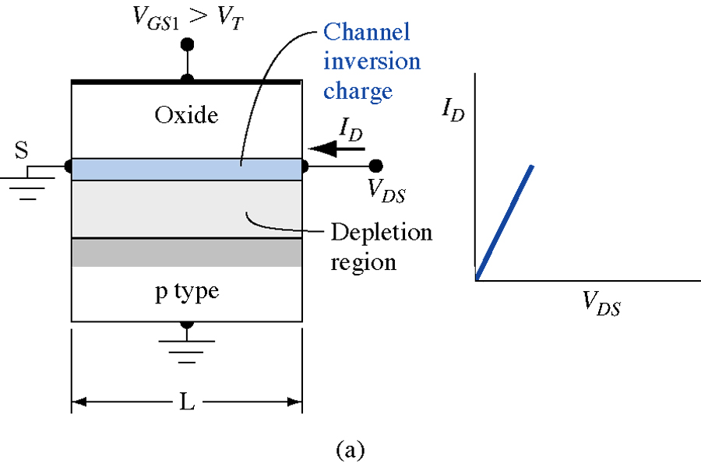
Linear regime

Slide 62
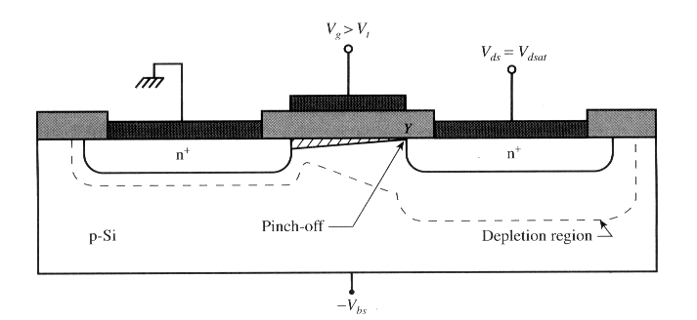
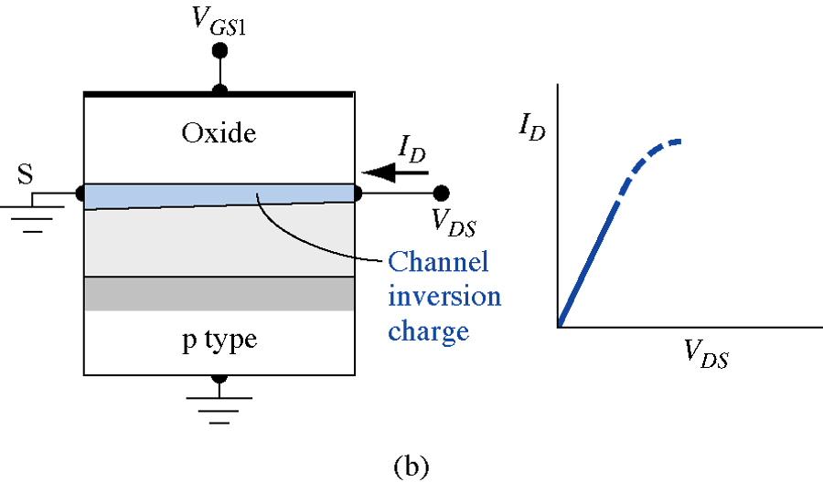
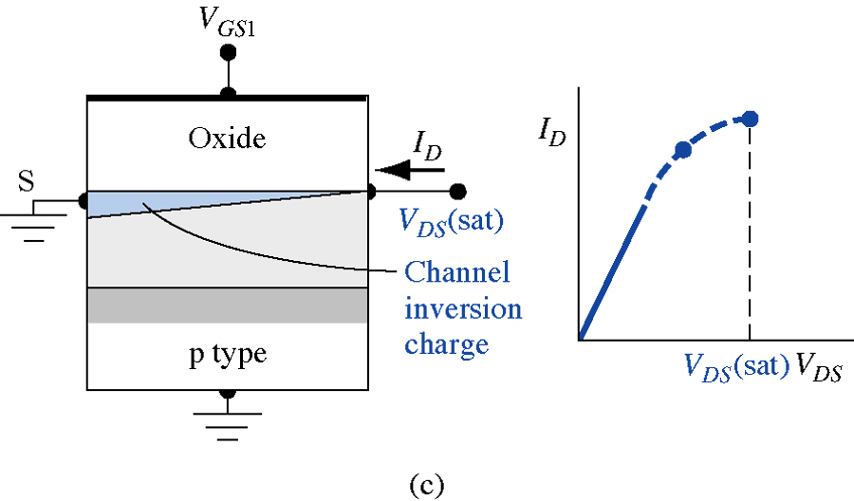
Saturation / linear limit

Slide 63
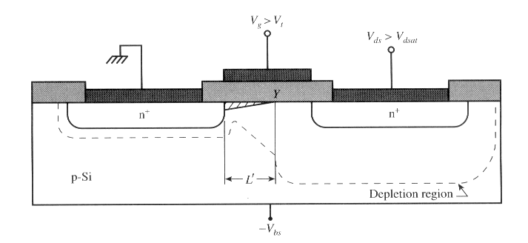
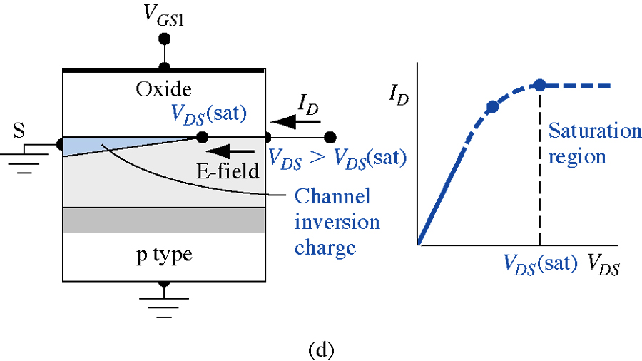
Saturation regime
Effective length of canal decreases from L to L’

Slide 64
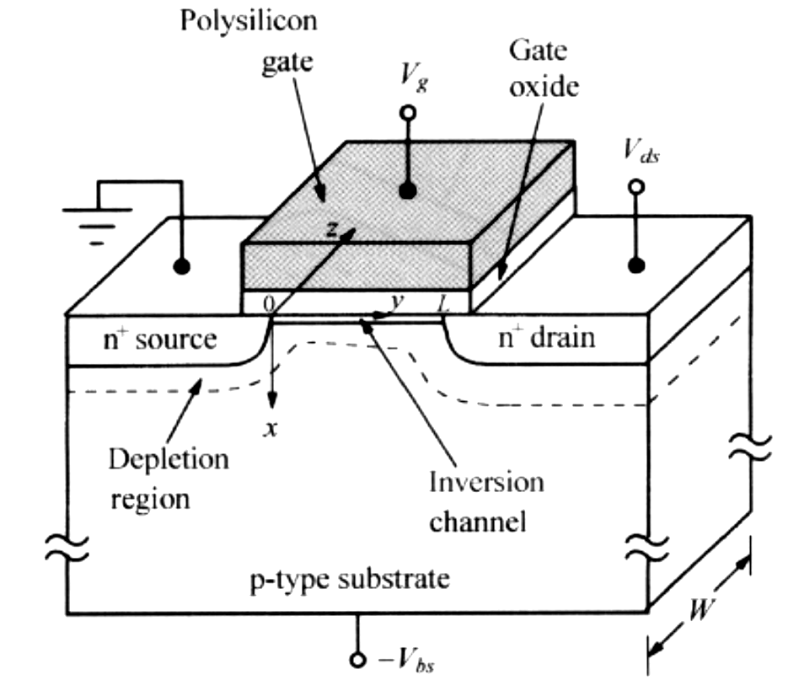
Basic MOSFET IV Model
L, canal length( y oriented)
W, canal width(z oriented)
V, voltage in the canal (f(y))
  V(y=0) = V(source) = V_{s} = 0 V
  V(y=L) = V (drain) = Vds
Vg, gate voltage
-V_{BS}, body voltage

Slide 65
Charge sheet approximation
Analytical solution ⬄ we simplify the model:
  Charge sheet approximation (x_{i}=0):
    We assume all the inversion charges are located at the silicon interface without any thickness
  No potentiel drop across this layer
  No band bending across this layer

Slide 66
Charge sheet approximation
First step: calculation of inversion layer charge function of Vg

Slide 67

Charge sheet approximation
Current density in the channel can be caused by diffusion and drift components
Current is simply given (integration over channel section)
There is a sign change because we want I_{DS}>0 in –y direction

Slide 68
Charge sheet approximation
The previous relation can be rewritten
If we remember that:
Current expression can be found
And so, by integrationg from y=0 to y=L and as current is independant of y:
conduction
diffusion

Slide 69
Charge sheet approximation
If we want to derive basic expressions for long channel current in linear and saturation regions, we can neglect drift component
with
After few simple steps:
!! C_{ox} is the oxide capacitance per surface unit (Fm⁻² ou Fcm⁻²)!!

Slide 70
Characteristics in the linear (triode) region
When V_{DS} is small (V_{DS} << 2Φ_{Fi}) , one can expand the previous equation into power series in V_{DS} and keep only first order term:
We recognize threshold voltage V_{T}.
In the linear region, the MOSFET simply acts like a resistor modulated by the gate voltage

Slide 71
Characteristics in the linear (triode) region
For larger values of V_{DS} we have to keep second order term (quadratic term) and a good approximation of current is:
with
C_{dm} is the bulk depletion capacitance in limit of strong inversion

Slide 72
Characteristics in the saturation region
Previous equation is a parabole. I_{ds} follows a parabolic curve with V_{DS} until a maximun (or saturation) value is reached when V_{DS} = V_{dsat}.
Drain current
In the case of thin oxide and low doping m can be reduced to 1 and yield the well known expression:
V_{DS}

Slide 73
Characteristics in the saturation region
Without any approximation (series expand,…), complete expressions for I_{DSAT} can be expressed as:
If we suppose high value for C_{ox} (thin oxyde) and low doping level, threshold voltage can be simplified as , and at the same time we can rewrite

Slide 74
Subthreshold characteristics
– weak inversion region
Three regimes:
  Triode (Linear)
  Saturation
  OFF state (if V_{g} < V_{T} for nMOS)
Transition ON /OFF is not so sharp
  Weak inversion for Φ_{fi} <V_{s} <2Φ_{Fi}
  Subthreshold behavior is of importance:
    Low power
    Low voltage
digital logic and memory circuits

Slide 75
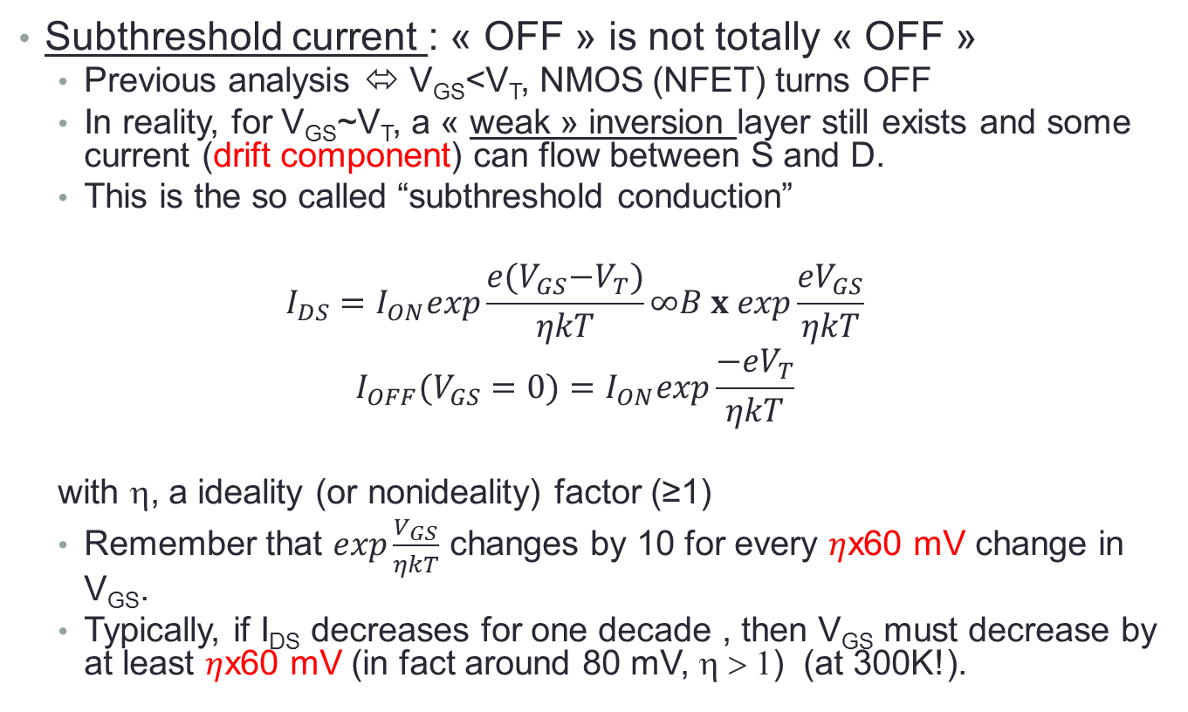
MOSFET basics
Subthreshold current : « OFF » is not totally « OFF »
  Previous analysis ⬄ V_{GS}<V_{T}, NMOS (NFET) turns OFF
  In reality, for V_{GS}~V_{T}, a « weak » inversion layer still exists and some current (drift component) can flow between S and D.
  This is the so called “subthreshold conduction”
  $$I_{DS}=I_{ON}exp\frac{e{(V}_{GS}−V_{T})}{ηkT}∞B x exp\frac{eV_{GS}}{ηkT}$$
  $$I_{OFF}(V_{GS}=0)=I_{ON}exp\frac{−{eV}_{T}}{ηkT}$$
  with η, a ideality (or nonideality) factor (≥1)
  Remember that $exp\frac{V_{GS}}{ηkT}$ changes by 10 for every $η$x60 mV change in V_{GS}.
  Typically, if I_{DS} decreases for one decade , then V_{GS} must decrease by at least $η$x60 mV (in fact around 80 mV, η > 1) (at 300K!).

Slide 76


MOSFET basics
For example:
$$I_{OFF}(V_{GS}=0)=I_{ON}exp\frac{−eV_{T}}{ηkT}$$
If we suppose V_{T}=0,3V
0,3V/80 mV=3,75
I_{ON}/I_{OFF} = 10^{3,75} ~ 5600
If V_{T}=0,6V, I_{ON}/I_{OFF} >10⁷ !!
Subthreshold current :
$I_{DS}=I_{ON}exp\frac{{e(V}_{GS}−V_{T})}{ηkT}$ (for V_{GS}<V_{T})
log I_{DS}
Exponential
Quadratic
I_{ON}
1 decade
I_{OFF}
~80 mV
V_{T3}
V_{T1}
V_{GS}
V_{T2}
OF COURSE WE WANT η CLOSE TO UNITY

Slide 77
Short channel MOSFETs
  Threshold voltage reduction
  Drain Induced Barrier Lowering (DIBL)
  Channel length modulation
  MOSFETs breakdown
  …

Slide 78
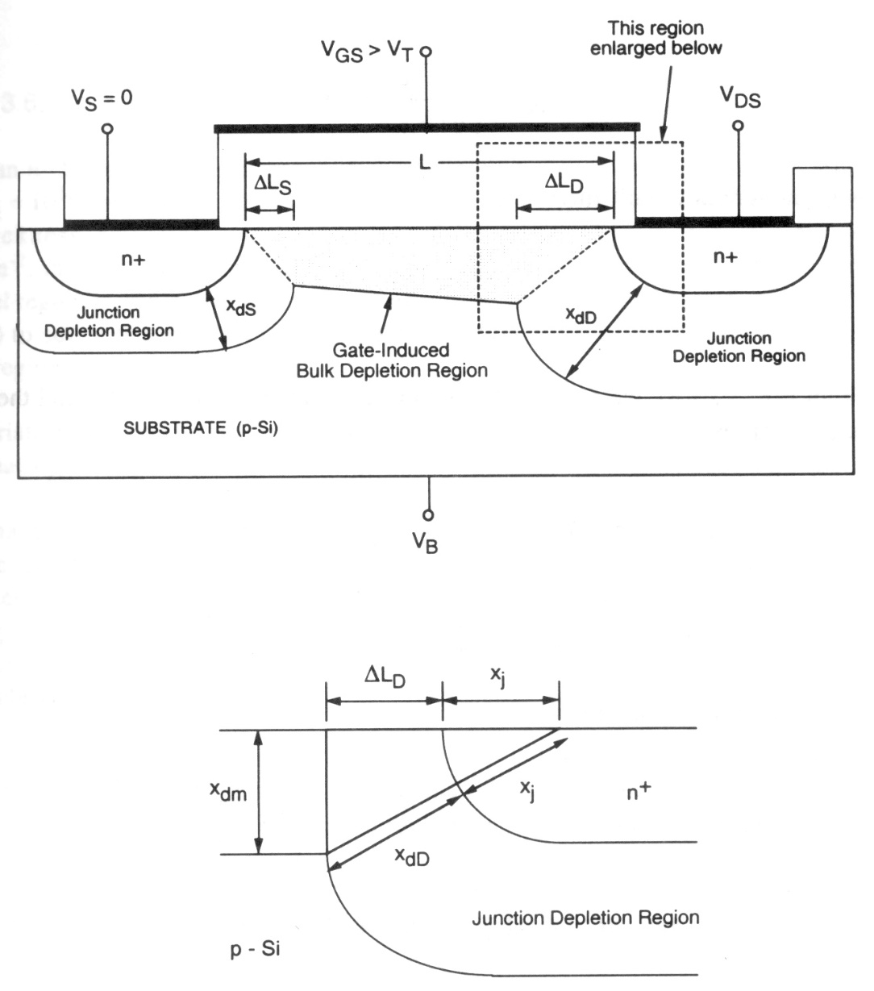
Threshold voltage reduction: short channel effect (Kang et al)
Origin:
  Previous V_{T} expression supposes channel depletion region comes only from gate
  In fact one part is created by depletion region associated by source/channel and drain/channel pn junctions
  Overestimation of charge induced by gate ⬄ overestimation of V_{T}
This reduction more prominent for MOSFET with shorter channel length

Slide 79
Threshold voltage reduction: short channel effect (Kang et al)
Origin:
  Previous V_{T} expression supposes channel depletion region comes only from gate
  In fact one part is created by depletion region associated by source/channel and drain/channel pn junctions
  Overestimation of charge induced by gate ⬄ overestimation of V_{T}
This reduction more prominent for MOSFET with shorter channel length

Slide 80
Threshold voltage reduction: short channel effect (Kang et al)

Slide 81
Threshold voltage reduction: short channel effect (Kang et al)
0,9
V
T0
0,8
Threshold voltage is function of:
  Channel length
  Drain –Source voltageV_{ds} through x_{dD}
0,7
Threshold voltage (V)
0,6
0,5
0,4
0,3
0
1
2
3
4
5
6
Channel Length (µm)

Slide 82
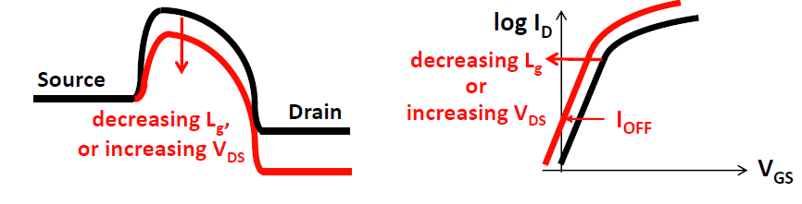
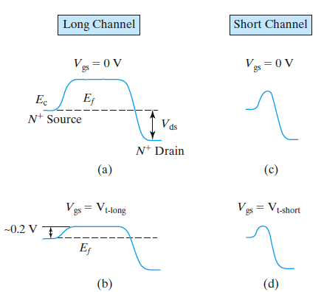
Drain Induced Barrier Lowering (DIBL)

Slide 83
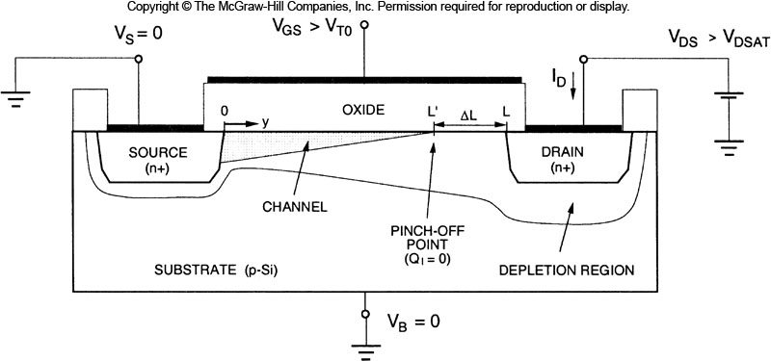
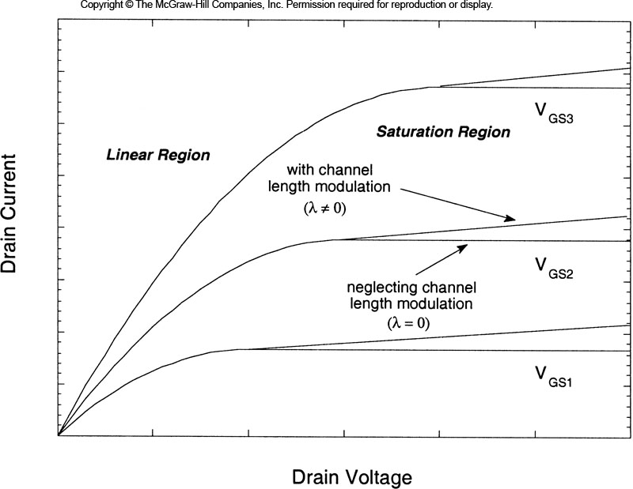
Channel length modulation (saturation operation)
At the onset of pinch-off (V_{DS}>V_{Dsat}), the effective channel length (the length of inversion layer) is reduced.

Slide 84
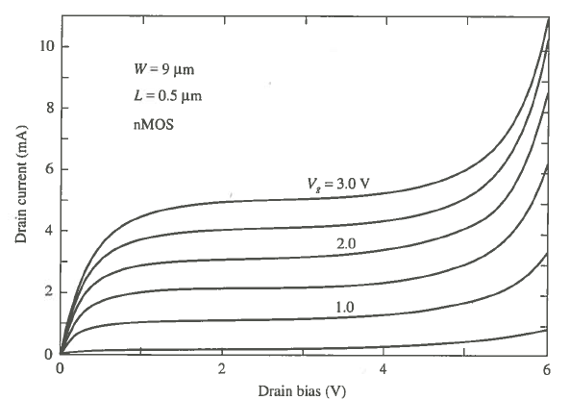
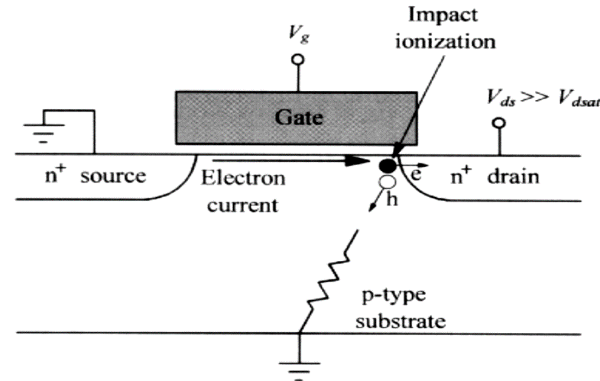
MOSFET Breakdown
2 main effects:
  punchthrough breakdown
    Punch through in a MOSFET is an extreme case of channel length modulation where the depletion layers around the drain and source regions merge into a single depletion region.
    Punch through causes a rapidly increasing current with increasing drain-source voltage
    No current saturation
  Impact ionisation at the drain:
    Electron acceleration in the channel
    Impact ionisation ⬄ holes electrons pairs
    generated
    Holes collected by substrate ⬄ substrate current
    ⬄ voltage drop in the channel
    Reduction of VT ( body effect)
    Increase of current and so on !
    Permanent dammage

Slide 85
MOSFET capacitances
Difficulties:
  In general, capacitances associated with MOS circuits are a complicated function of geometries and process
  Not lumped capacitances but distributed capacitances
In the following, first approximation model
  Sufficiently accurate to represent main characteristics of MOSFET charge voltage behavior
  All the capacitances are lumped
Three differents physical origins
  Overlay capacitance
  Oxyde capacitance
  Junction capacitance
  Important point : capacitances are dependent of bias voltage / working point.

Slide 86
MOSFET capacitances
Overlay capacitances:
  L_{D}, gate – drain and gate – source overlay
  L_{M}, mask length
L=L_{M} - 2.L_{D}
gate
L_{D}
L_{D}
W
(n⁺)
L
(n⁺)
L_{M}

Slide 87
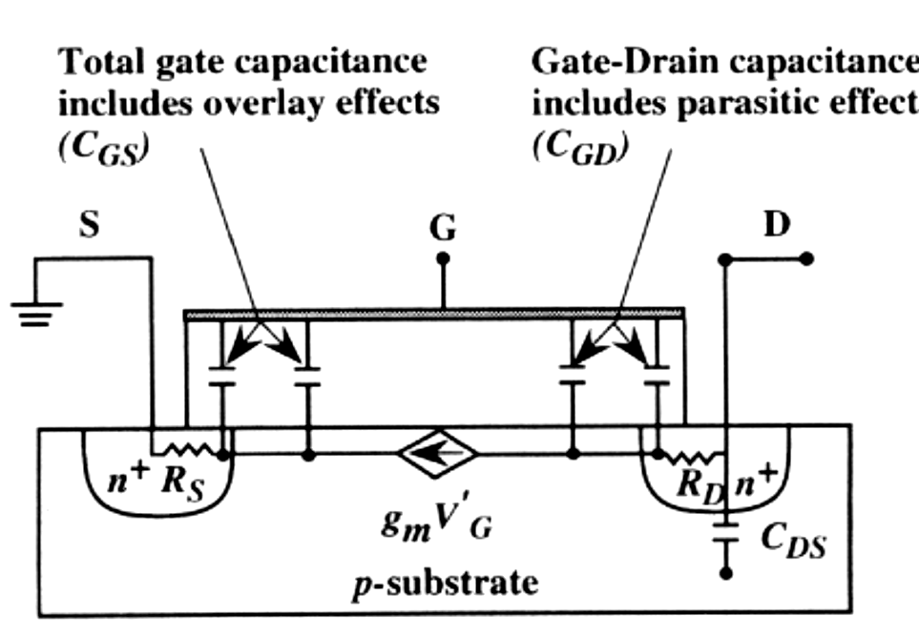
MOSFET capacitances
Lumped representation of parasistics capacitances
Equivalent model (with overlap capacitances)
C_{gb}
D
C_{db}
C_{gd}
MOSFET
(DC Model)
G
B
C_{gs}
C_{sb}
C_{db}
S

Slide 88
Gate – Channel capacitances
Cut off mode:
Linear mode
Saturation mode
C_{gs} = C_{gd} = 0
C_{gb} = C_{ox}WL
channel
channel

Slide 89
Oxyde capacitance
Capacitance | Cut off | Linear | saturation
C_{gb}(total) C_{gd}(total) C_{gs}(total) | C_{ox}WL C_{ox}WL_{D} C_{ox}WL_{D} | 0 | 0

Slide 90
Dynamic characteristics (1)
Conductance:
  Linear mode
  Saturation mode

Slide 91
Dynamic characteristics (2)
transconductance: device speed
  linear
  « active region »

Slide 92
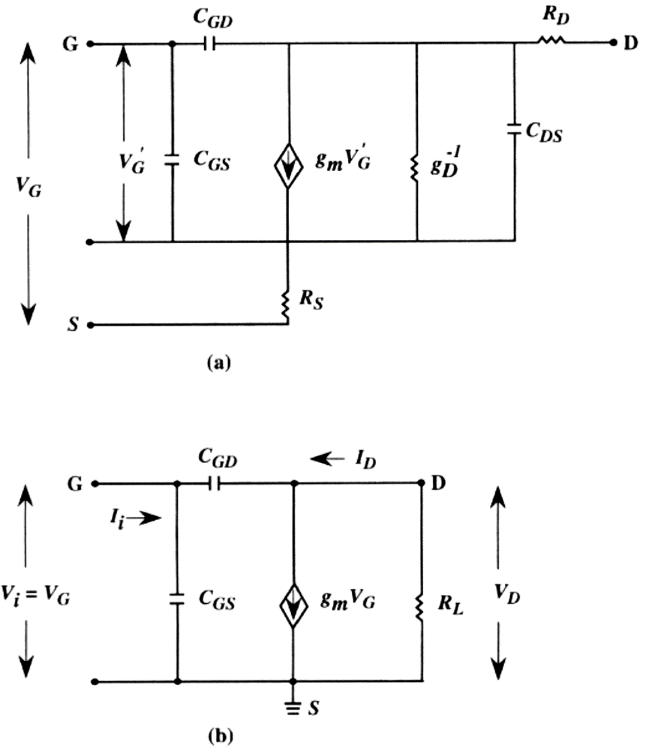
HF Caracteristics
Cut off frequency ⬄current gain = 1
If we neglect jωR_{L}C_{gd} (small)
C_{M} : Miller capacitance

Slide 93
HF Caracteristics
If C_{M} = 0 (or minimum) ⬄ cut off frequency is maximum (saturation mode):
or (if short chanel and/or v_{sat} )

Slide 94
HF Caracteristics
An other figure of merit : power gain =1 ⬄ oscillation frequency
R_{g}: gate resistance
R_{s} : negligeable
Ref: (Tsividis)

Slide 95
MOS transistors InverTERS
Statics characteristics

Slide 96
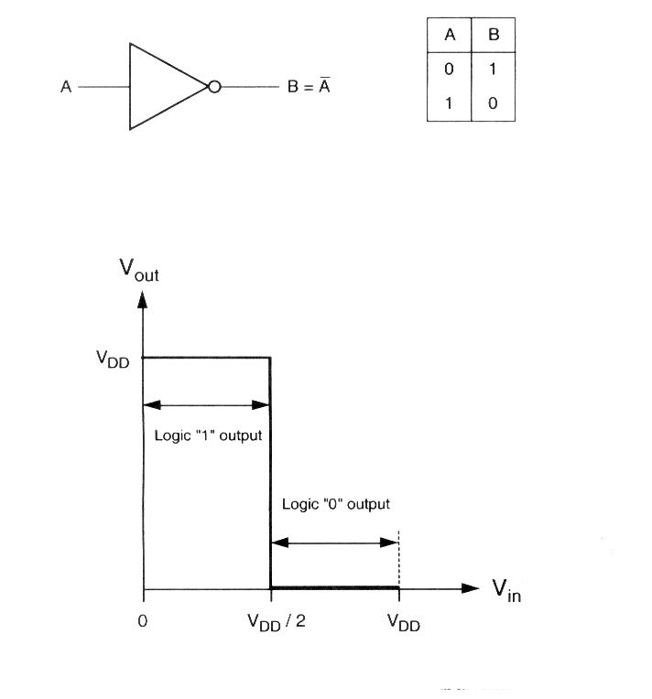
ideal Inverter : definition
Input voltage: V_{in}
Output voltage: V_{out}
Inverter threshold voltage:V_{th}=V_{DD}/2
Logic « 1 » output :
  0<V_{in}<V_{th}
Logic « 0 » output:
  V_{th}< V_{in} <V_{DD}
Vertical drop in ideal case

Slide 97
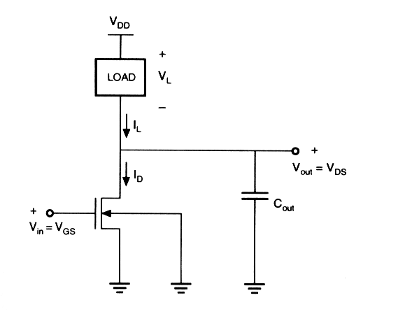
NMOS Inverter: general circuit structure
Load: active (MOS) or passive (resistor)
« driver »
C_{load} :lumped capacitance
Input Voltage: V_{in}=V_{gs}
Output Voltage: V_{out}=V_{ds}
DC domain: no input current neither output current
Kirchoff’s current law: I_{LOAD}(V_{L}) = I_{DS}(V_{in}, V_{out})

Slide 98
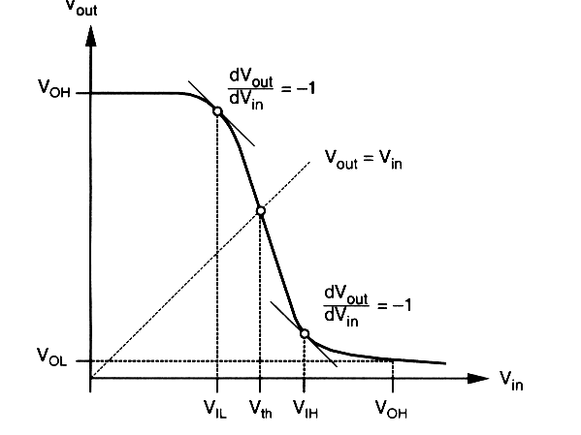
Inverter: voltage transfer characteristics
With analytical solving
I_{DS} ( V_{in} ,V_{out} )=I_{L}( V_{L} ) we found the VTC characteristics:
V_{out} = f ( V_{in} )
Key voltages:
  V_{IL} : maximum input voltage wich can be interpreted as a « 0 » logic input
  V_{IH} : minimum input voltage wich can be interpreted as a « 1 » logic input
  V_{OL} : minimun ouput voltage when the output level is logic « 0 »
  V_{OH} : maximum ouput voltage when the output level is logic « 1 »

Slide 99
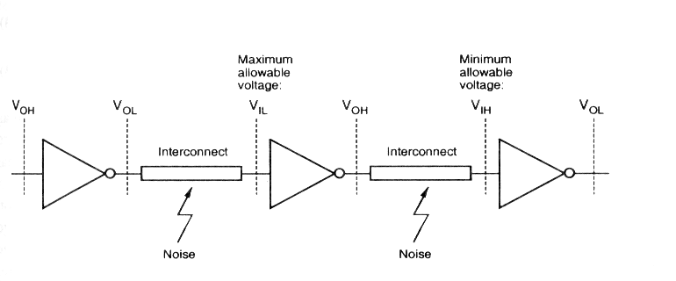
Inverters: noise margins
Interconnexions and gate noise can add parasitics voltage ⬄ logic faults . We introduce for quantify the noise immunity of the circuit the «noise margins ».
The noise immunity increases with the noise margins

Slide 100
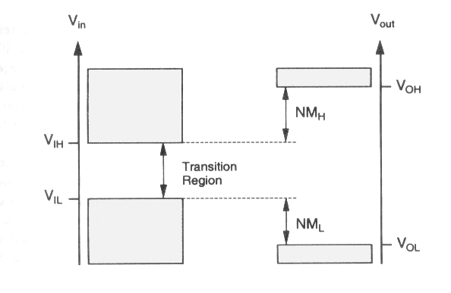
Inverters: noise margins
V_{OH}’
Uncertainty region⬄ must be reduce ⬄we must have V_{IL}~V_{IH}
⬄ VTC close to ideal inverter
V_{OL}’

Slide 101
Inverters: brief summary
Preceding discussions of inverter static (DC) characteristics show that shape of the VTC in general and noise immunity in particular are very important criteria for design priorities.
  For any inverter circuit five critical points (V_{IL}, V_{IH},…) fully determine the properties.
  Accurate estimation of these voltage points have to be determined.

Slide 102

Resistive-load Inverter
V_{in}=V_{GS}
  V_{in}=« 1 »: n-MOS is ON ⬄ at first order, Drain grounded ⬄V_{out} = « 0 »
  V_{in}=« 0 »: n-MOS is OFF ⬄ open circuit ⬄ I_{L} = I_{DS} = 0 ⬄ V_{out}= V_{DD}= « 1 »
R_{L}
C_{L}
Input Voltage Range | Operating Mode
V_{in}<V_{T0} | Cut off
V_{T0}<V_{in}<V_{out}+V_{T0} | Saturation
V_{in}>V_{out}+V_{T0} | Linear

Slide 103

Resistive-load Inverter : VTC

Slide 104

Resistive-load Inverter : VTC
( good exercise ! )

Slide 105

Saturated enhancement-type nMOS Inverters :
V_{GS} = V_{DS} ⬄ V_{GS} -V_{T} < V_{DS} ⬄ saturation mode
Warning : if V_{out}>V_{DD}-V_{T} ⬄ cut-off ⬄V_{OH}=V_{DD}-V_{T}

Slide 106

Saturated enhancement-type nMOS Inverters : graphic analysis
V_{GS}
The representative points of the load line are given by :
V_{GS} = V_{DS}
Non linear resistance
The load NMOS is equivalent to a non linear resistance
V_{DS}

Slide 107

Saturated enhancement-type nMOS Inverters : graphic analysis
I_{D2}, µA
Load
V_{DS1}=V_{DD} - V_{DS2} = 6 - V_{DS2}
Driver
75
V_{DS2}
4
75
V_{DS1} = 6 – 4 = 2 V
I_{D2} = 75 µA = I_{D1}
2

Slide 108

Saturated enhancement-type nMOS Inverters : graphic analysis
B
75
2
NM_{H} = V_{OH} -V_{IH} = -0.2 V <0
By changing the ratio W/L, we can improve NM.

Slide 109

Inverter with linear enhancement type load
Load transistor never in saturation mode:
  V_{GS,load} – V_{T,load} >V_{DS,load} (1)
  V_{GS,load} –V_{DS,load} = V_{GG} – V_{DD}
  (1) OK ⬄ V_{GG} – V_{DD} >V_{T,load}
  non saturated load
drawback : 2 separated power supply voltage !!

Slide 110


Inverter with linear enhancement type load
V_{GG} = +9V V_{DD} = +6V
T₂
Load
resistance
V_{DS1}
T₁
V_{GS1}
V_{GS2} - V_{DS2} =V_{GG} – V_{DD} = 3V
V_{DS2} = V_{GS2} – 3V
Load
resistance

Slide 111

Inverter with linear enhancement type load
V_{DS1} = 6 – V_{DS2}

Slide 112
Depletion Load NMOS inverter
V_{DD} = +6V
Vin | Vout | Driver | load
V_{OL} | V_{OH} | Cut off | Linear
V_{IL} | ~V_{OH} | Saturation | Linear
V_{IH} | small | Linear | Saturation
V_{OH} | V_{OL} | linear | saturation
Driver : enhancement ⬄ V_{T,Driver} >0
Load : depletion ⬄ V_{T,load} <0 ⬄ V_{GS,load} =0 >V_{T,load}
V_{SB,load} = V_{DS,pilote} = V_{out} ⬄ V_{T,load} sensitive to body effect

Slide 113

Depletion Load NMOS inverter
V_{DS2} = 0 V, I_{DS2} = 0 µA
V_{DS1} = 6 – 0 = 6 V
V_{DS2} = 3 V, I_{DS2} = 22 µA
V_{DS1} = 6 – 3 = 3 V

Slide 114
Depletion Load NMOS inverter
( good exercise! )
Drawback (compare to enhancement load Inverter):
Additional processing step (V_{T} adjust for load)
Advantages (compare to enhancement load Inverter):
Sharp VTC transition
Better noise margins
Single power supply
Smaller layout area

Slide 115
Depletion Load NMOS inverter: power considerations
V_{in} = 0 et V_{out} = V_{OH} ⬄ driver is cut off ⬄ I_{DS}=0. No power
V_{in}= V_{DD} et V_{out} = V_{OL} ⬄ both transistors ON ⬄ large current
50% of time logic« 1 »
unacceptable

Slide 116
C-MOS inverter
All previous Inverters are based on :
  enhancement driver NMOS
  a load which can be a resistor, an enhancement or depletion NMOS.
Major drawback: in one state (output level « 0 ») DC consumption or power dissipation nonzero
New concept /design :
  One enhancement NMOS and one enhancement PMOS (Complementary MOS or CMOS).
  Depending on input Voltage, NMOS is the load and PMOS the driver and vice versa.
  Advantages:
    No DC ( steady state) power dissipation ( except leakage current)
    Full output voltage swing between V_{DD} and 0
    Very sharp VTC transition : very similar to ideal inverter

Slide 117

C-MOS inverter
S
D
D
S
V_{GS,p} | -(V_{DD} – V_{in})
V_{DS,p} | -(V_{DD} – V_{out})
V_{GS,n} | V_{in}
V_{DS,n} | V_{out}

Slide 118

C-MOS inverter
The structure complexity of CMOS is the price to be paid for the improvements achieved in power consumption and the noise margins

Slide 119

C-MOS inverter
V_{Tn} > 0 et V_{Tp} < 0
1st case: V_{in} < V_{Tn}
  V_{GS,n} < V_{Tn} ⬄ nMOS cut off zero current
  V_{GS,p} < V_{Tp} ⬄ pMOS ‘ON ‘ V_{out} = V_{DD} = V_{OH}
2nd case: V_{in} > V_{DD} + V_{Tp}
  V_{GS,n} > V_{Tn} ⬄ nMOS ‘ON ’ zero current
  V_{GS,p} > V_{Tp} ⬄ pMOS cutoff V_{out} = V_{OL} = 0

Slide 120

C-MOS inverter

Slide 121
C-MOS inverter
Region | V_{in} | V_{out} | nMOS | pMOS
A | < V_{Tn} | V_{OH} | Cut off | linear
B | V_{IL} | « 1 » ≈V_{OH} | Saturation | linear
C | V_{th} | V_{th} | Saturation | Saturation
D | V_{IH} | « 0 » ≈V_{OL} | linear | Saturation
E | > (V_{DD} + V_{T,p} ) | V_{OL} | linear | Cut off
Consumption zone when switching

Slide 122
C-MOS inverter

Slide 123

C-MOS inverter: switching characteristics
Interconnect effects
C_{int} represents the parasitic capacitance between the two inverters

Slide 124

C-MOS inverter: switching characteristics
To simplify the problem, all the capacitances are combined into a unique lumped linear capacitance C_{load}
The question of inverter transient response is reduced to finding the charge-up and charge-down time of a single capacitance which is charged and discharged through a transistor (NMOS or PMOS).
C_{load}

Slide 125

C-MOS inverter: switching characteristics
Delay-time or Propagation-time:
τ_{PLH} : delay time from « 0 » to « 1 ».
τ_{PHL} : delay time from « 1 » to « 0 ».
The average propagation delay time :

Slide 126

C-MOS inverter: switching characteristics
Output voltage Rise and Fall time:
V_{OH}
V_{OL}

Slide 127


C-MOS inverter: switching characteristics
Calculation of delay times:
Fall time calculation:
  V_{in} switches from V_{OL} to V_{OH}
  nMOS is turned ‘ON’ and it starts to discharge C_{load}
  pMOS is switched off⬄ I_{D,p} ≈0

Slide 128

C-MOS inverter: switching characteristics
Be carefull : during the switching, operating mode of MOS changes !!
In our case , we have to decompose the calcul in two delay-times
NMOS in saturation ?
V_{GSn} – V_{TN} < V_{DS} ⬄ V_{in}-V_{TN} <V_{out} ⬄ V_{OH} – V_{Tn} < V_{out}

Slide 129
C-MOS inverter: switching characteristics
After few steps

Slide 130
C-MOS inverter: switching characteristics
Other method (more simple, less accurate): average current method

Slide 131
C-MOS inverter: switching characteristics
Power dissipation for a gate CMOS during switching : this is the power used to charge and discharge the capacitance C_{load}.

Slide 132

C-MOS inverter: switching characteristics
Another source of power consumption: the short-circuit current, ie a direct pathway from power supply to ground through PMOS and NMOS, both of them being in “ON” state.

Slide 133
bibliographic references
S.M. Sze « Physics of semiconductors devices », 2° edition, Wiley and Sons, New York, 1981
H.Mathieu, « Physique des semi-conducteurs et des composants électroniques », 4° edition, Masson 1998.
J. Singh, « semiconductors devices : an introduction », McGraw-Hill, Inc 1994
D.A. Neamen, « Semiconductor physics and devices », McGraw Hill, 2003
Y.Taur et T.H. Ning, « Fundamentals of Modern VLSI devices », Cambridge University Press, 1998.
K.K. Ng, « complete guide to semiconductor devices », McGraw-Hill, Inc, 1995
E. H. Nicollian et J. R. Brews, « MOS Physics and Technology », John Wiley and Sons, 1982
S.M. Kang et Y. Leblebici, « CMOS Digital Integrated Circuits : analysis and design », Mc Graw Hill, 2° edition., 1999
J. Millman et A. Grabel, « microelectronique », Mc Graw Hill, 1995
Chenming C. Hu « Modern Semiconductor Devices for Integrated Circuits », Prentice Hall, 2009
Figures and tables mainly from these references

Slide 134
MERCI!
Thank you for your attention!
感谢您的关注

