Slide 1
Bipolar
Transistor

Slide 2
Bibliography:
  H. Mathieu, « Physique des semi-conducteurs et des composants électroniques », 4° édition, Masson 1998.
  D.A. Neamen, « semiconductor physics and devices », McGraw-Hill, Inc 2003.
  P. Leturcq et G.Rey, « Physique des composants actifs à semi-conducteurs », Dunod Université, 1985.
  J. Singh, « semiconductors devices :an introduction », McGraw-Hill, Inc 1994.
  Y. Taur et T.H. Ning, « Fundamentals of Modern VLSI devices », Cambridge University Press, 1998.
  K.K. Ng, « complete guide to semiconductor devices », McGraw-Hill, Inc 1995.
  D.J. Roulston, « Bipolar semiconductor devices », McGraw-Hill, Inc 1990.

Slide 3
Plan
Geometry
Principle of operating
Static characteristics
Ebers-Moll Equations
Static parameters ( gain…)
Second order effects
Switching performances
Transistor in HF domain
Hetero-junction Bipolar Transistor (HBT or TBH)

Slide 4
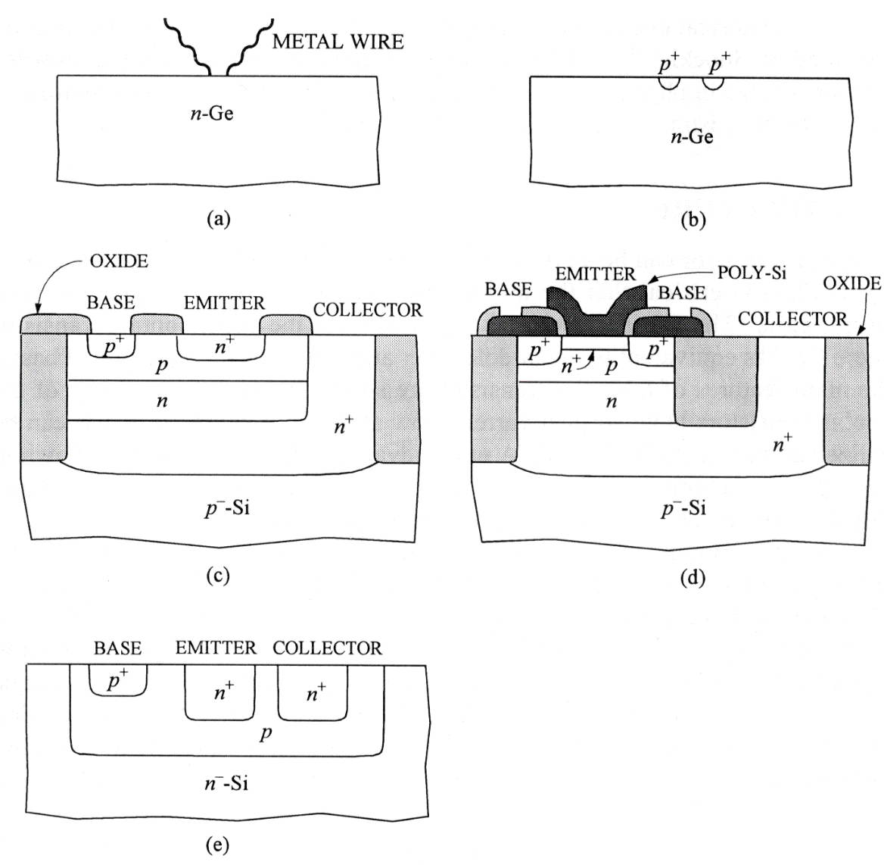
Geometry
Geometry:
  Lateral
  Vertical
For digital circuits, vertical design
vertical
C
B
E
lateral
npn

Slide 5
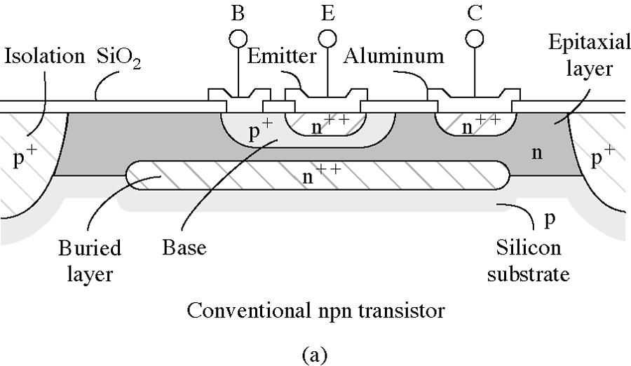
Geometry for IC
Muller et Kamins, « device electronics for IC »,2nd Ed., Wiley, 1986

Slide 6
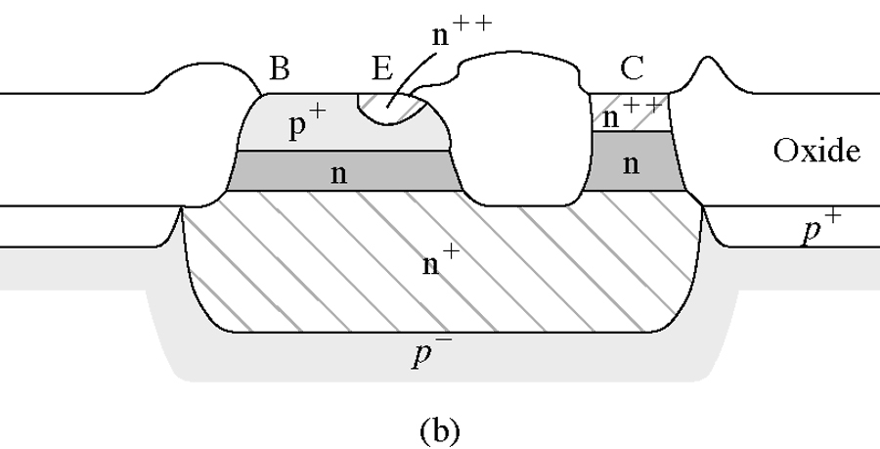
Geometry with insulating oxide
Muller et Kamins, « device electronics for IC »,2nd Ed., Wiley, 1986

Slide 7
BJT always present: why?
speed
Low noise
High gain
Low output resistance
  Still present in mobile phone ( analog part)
  Low density, mainly in power stage
  BiCMOS
Analogue
amplifier

Slide 8
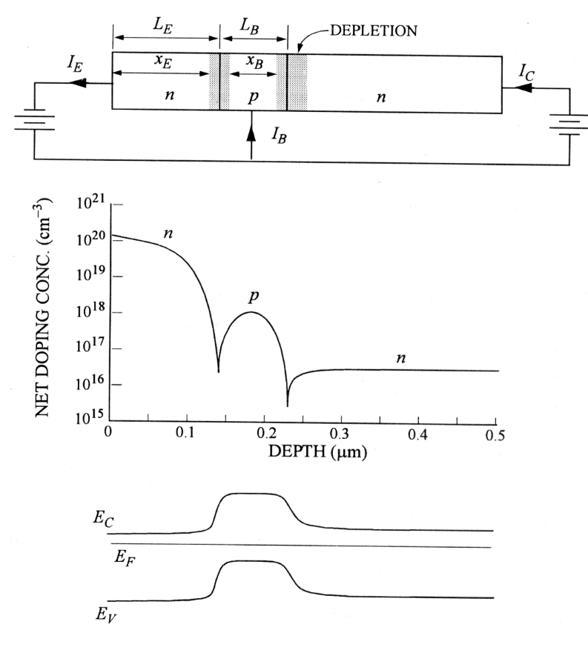
Working principle
2 PN Junctions with one common region (base)
  The first Junction (EB) will inject carriers
  The second one (CB) will collect carriers
The base must be thin (lower than diffusion length)

Slide 9
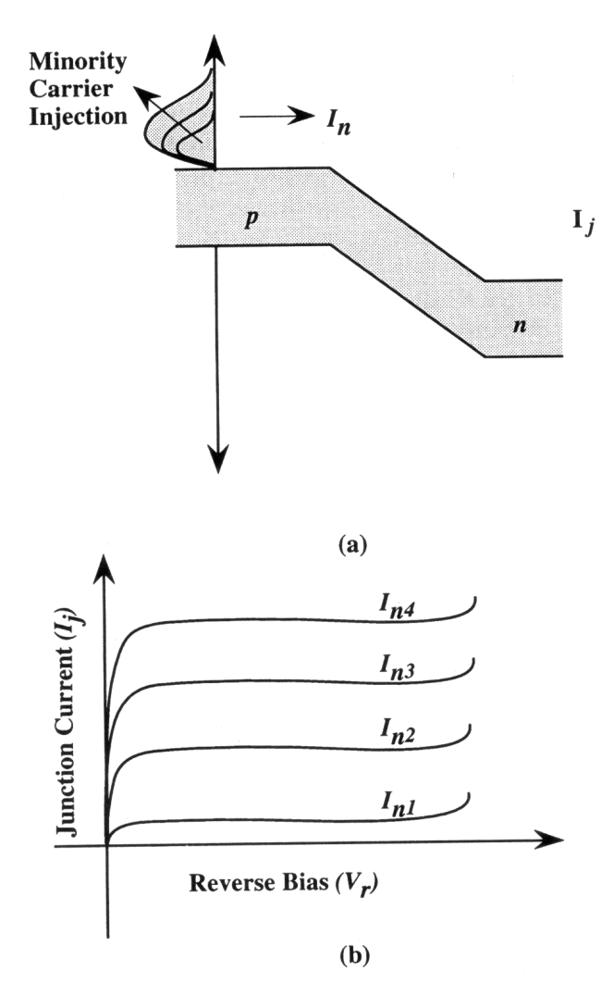
Working principle
Reverse biased Junction:
  Low current due to empty tank , reservoir.
  By modifying the filling of the tank, we can modulate the collected current (collector)
  We fill the reservoir ( the base) par a forward bias of the EB junction.

Slide 10
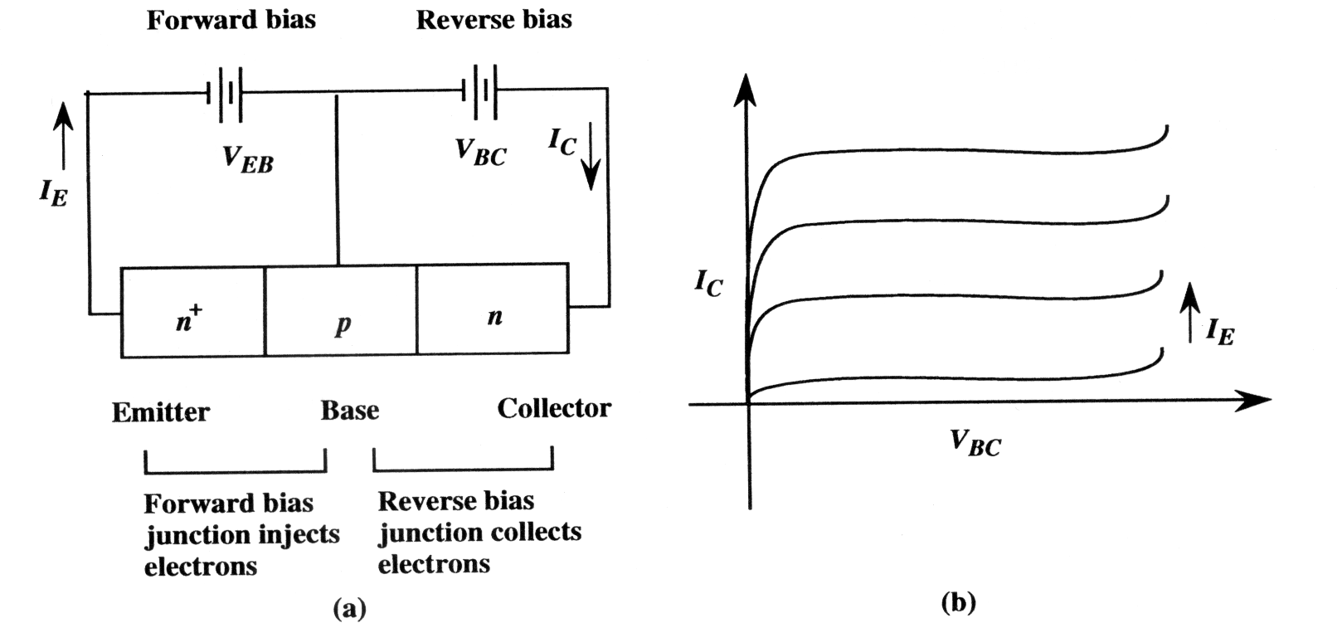
Working principle
The reverve biasing CB junction creates a favorable electric field for the collect
Conditions:
  Thin base:
    Avoid recombination effects
  Ligthly doped base compared to emitter
    favors one type of injected carriers (better injection efficiency)

Slide 11
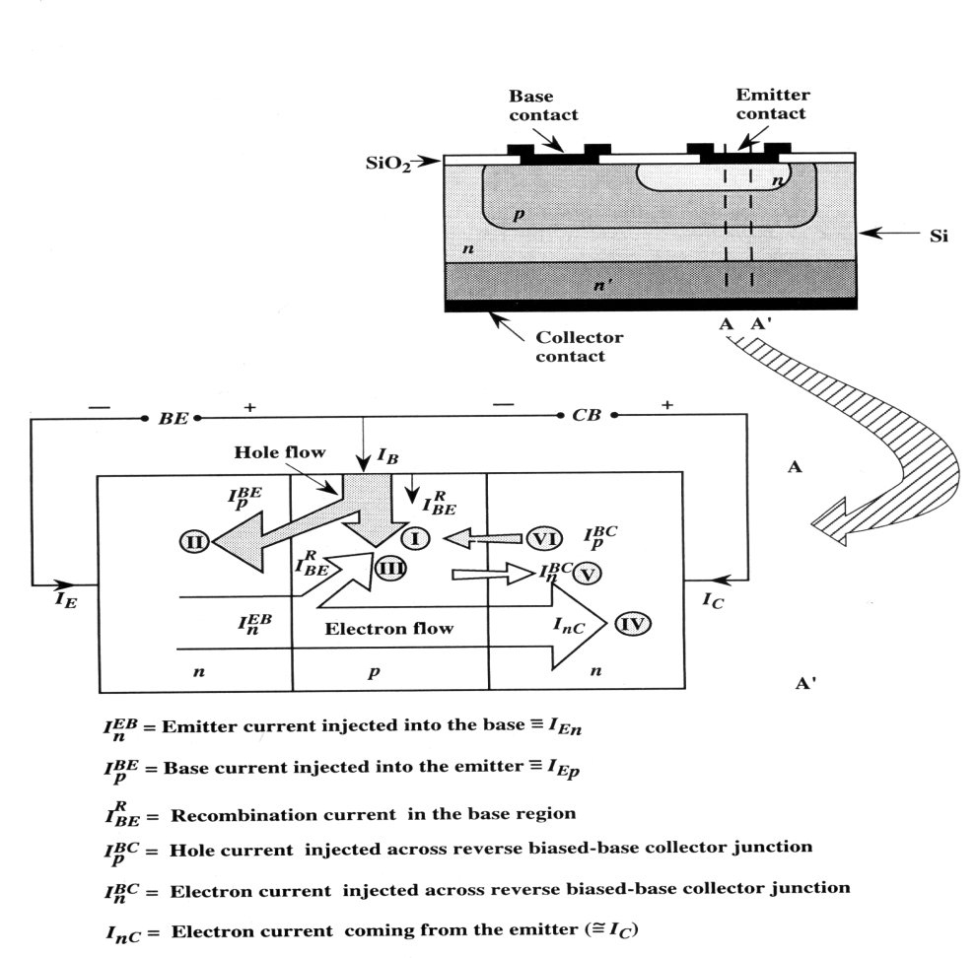
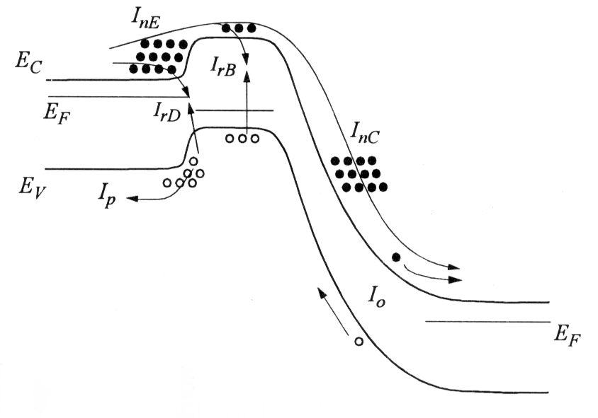
Statics characteristics
NPN Transistor

Slide 12
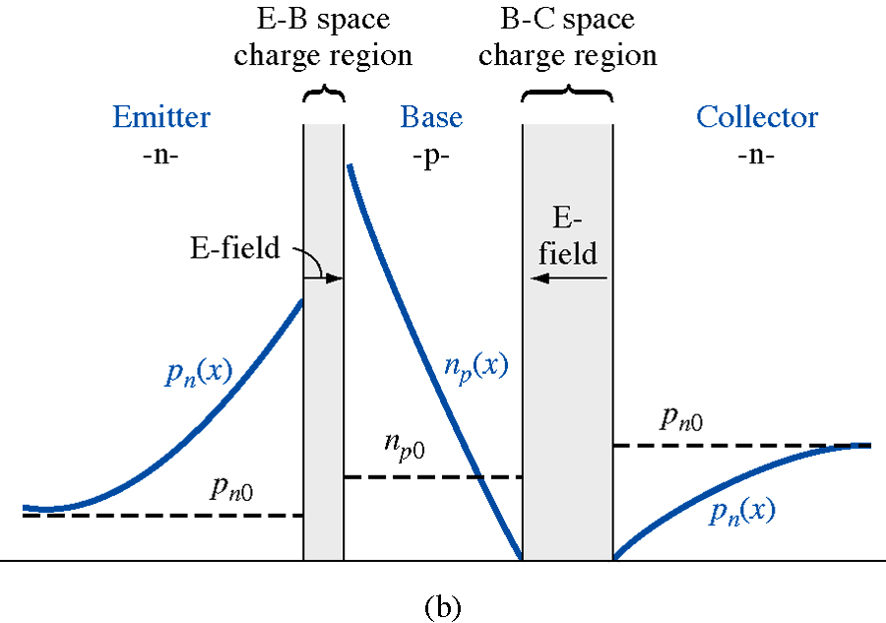
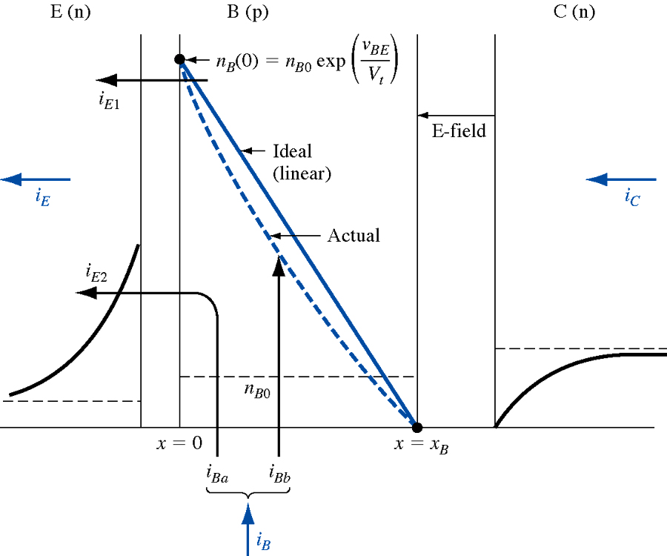
Minority carrier distribution in a forward biased npn transistor
ideal
With recombination

Slide 13
Statics characteristics + simplifying hypotheses
No recombination in the Base ! ( )
1D Approximation
Homogeneous doping in the Base
Low Injection
NPN Transistor

Slide 14
Current components in the NPN Transistor
In the neutral Base region:
  Fundamental equation
  and ,
  Integrating from E-B to C-B:
  We obtain:
  In forward active regime, J_{n} is negative ( e⁻ toward positive x)

Slide 15
Current components in the NPN Transistor
and:
in the case of uniform base doping
So:
Saturation current of electrons in the PN narrow junction ( or without recombination in the Base).
with :
Gummel number in the Base (s/cm⁴)

Slide 16
Current components in the NPN Transistor
Emitter current
Collector current
We get:
I_{B}
I_{E}
J_{pE}
J_{n}
J_{pC}
I_{C}
E
B
C
NPN

Slide 17
Current components in the NPN Transistor
I_{B}
I_{E}
J_{pE}
J_{n}
J_{pC}
I_{C}
And :
E
B
C
NPN

Slide 18
Statics characteristics
Forward active region:
  E-B (forward) and C-B (reverse)

Slide 19
Gummel number concept
The concept of a Gummel number simplifies the I_{C} model because G_{B} contains all the subtleties of transistor design that affect I_{C}:

Slide 20
Statics characteristics
Emitter injection efficiency:
DC common base current gain:
DC common emitter current gain :
NB:if we neglect recombination process and are equivalent

Slide 21

Statics characteristics
Base transport factor:
  Take into account recombination in neutral base region (Qs is the excess charge in the base)

Slide 22
Statics characteristics
Recombination factor:
  Take into account recombination in depleted base region
with W_{T}, width of E-B space charges.
When we add up all the contribution to the base current we get:

Slide 23
Statics characteristics
The common emitter gain can be expressed as:
    I_{B} intrisic base current (no recombination)
    I_{rB} recombination current in the neutral base region
    I_{rD} recombination current in the depletion zone of EB junction
Modern Transistors:
If V_{BE}>0,72V then exp() larger than 10⁶

Slide 24
Other modes of operation
E
B
C
n_{ex}(0)
QS1
Saturation mode (regime):
  The two junctions are forward biased.
W_{B}
n_{ex}(W)
QS2
W_{B}
QS1+QS2
n_{ex}(0)
n_{ex}(W)
W_{B}

Slide 25
Saturation mode
Low injection : (Q_{S}<<Q_{B}):
  Current is due to saturation charge injected into the base, ie Q_{ST} = Q_{S1} +Q_{S2}
  If we deal with « narrow » junction, this charge is simply given by the surface of ½ trapeze (linear decay)

Slide 26
Saturation mode
Low injection: (Q_{S}<<Q_{B}):
  An other « view » of saturation charge (from Ablard):
    We consider transistor in active mode with a charge Q_{SN} and a charge Q_{SAT} (we have to determine) which supply the same saturation current I_{csat}.
n(x)
Q_{ST} = Q_{S1}+Q_{S2}=Q_{SN}+Q_{SAT}
Base
We get :
Q_{SAT}
Q_{SN}
0
W_{B}
Responsible for the degradation of dynamic performance

Slide 27
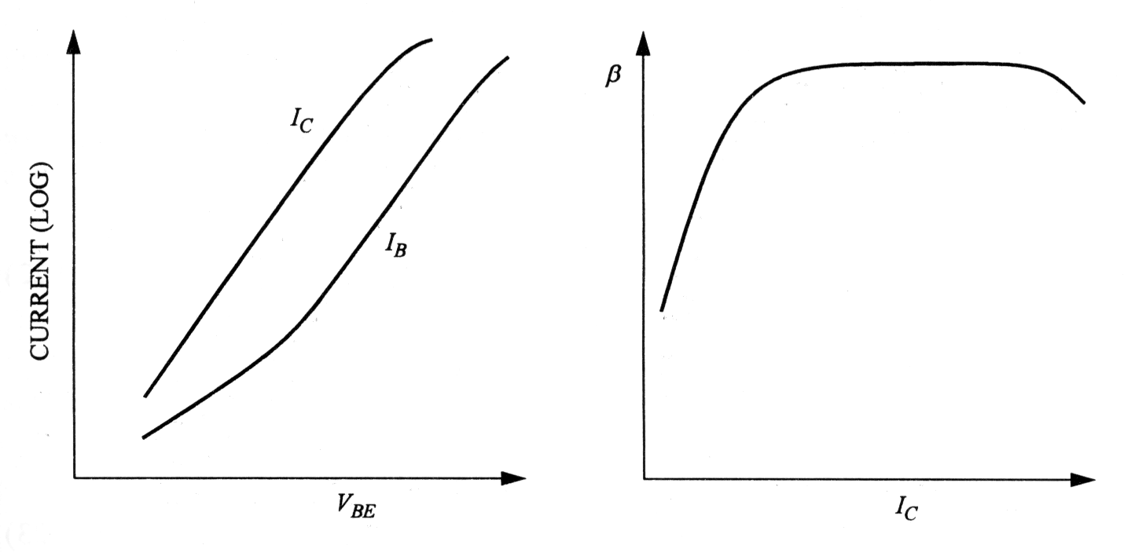
Nonideal Effects
« Gummel plot »:
  Graph of I_{C} and I_{B} versusV_{BE}
1
3
2

Slide 28
Nonideal Effects
  Early effect / collector punchthrough
  Base – collector junction breakdown
  Emitter and Base serie resistance (3)
  I_{c} « collapse » fort high current (1)
  « crowding effect »

Slide 29
  Early effect / collector punchthrough
At "first glance" Ic is independent of V_{CB}
In fact we have the modulation of the width of the neutral region in the base, so in the same way Q_{B}+Q_{S} , and so I_{c} !
if V_{BC}
ZCE B-C
W_{Beff}
I_{c}

Slide 30
  Early effect / base punchthrough
Collector current is due to diffusion of electrons in the base
( h₂₂ )

Slide 31
  Early effect / base punchthrough
At the limit:
  The BC space charge « depletes » totaly the neutral base
  collector injects directly current into the emitter because energy barrier is lowering
  Current only limited by serie resistance R_{serie} from E and C
  For a thin Base region, need to increase base doping to limit SCE enter into the base

Slide 32
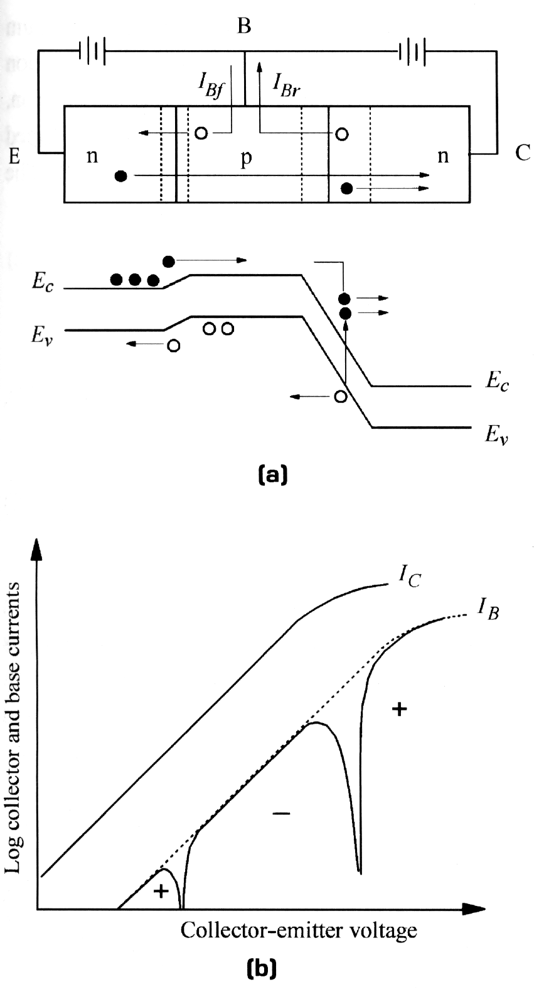
Base - Collector junction breakdown
Avalanche of BC:
  Often occurs before punchthrough
  How to prevent it?
    Lowering the electric field:
      Reduce the doping gradient in the collector
      Lightly doped layer between base and collector
Ionisation par impacts

Slide 33
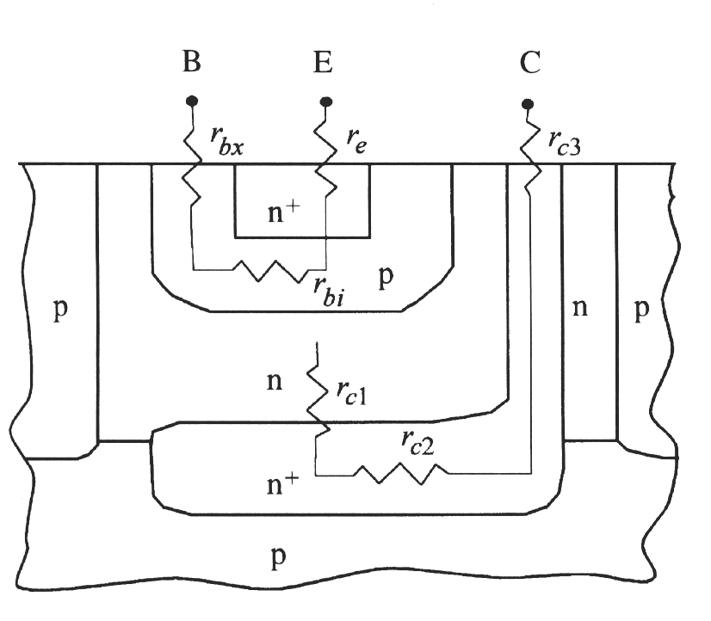
Emitter and Base resistance (effet 3)
At low current negligeable effects
In high speed circuits, B-C allways reverse biased (r_{c2} and r_{c3} as low as possible)
  Resistances r_{c} have no effects on current flow
Only r_{e} and r_{b} play a major role .
  IR drop Voltage
Measured current:I_{B’}

Slide 34
Collector « collapse » for high injection level (effect 1)
Number of physical mechanisms can cause this falloff of I_{C0:}
  Increase of the charge (holes) into the base (maintain neutrality)
  Increase the width of the quasineutral base layer (push off the space charge into the collector): Kirk effect

Slide 35
And the effect #2 ????????????????

Slide 36
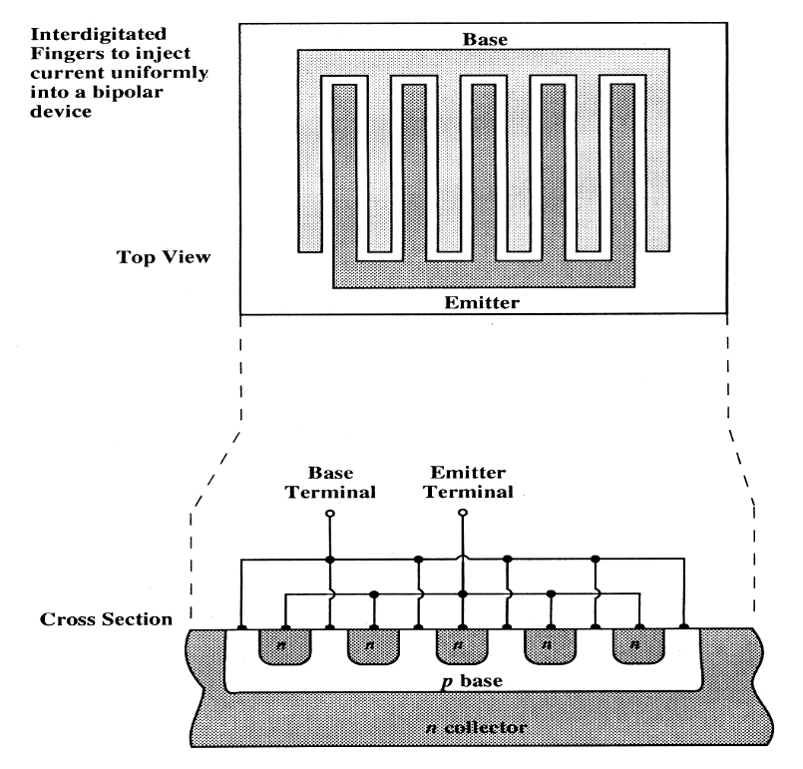
« crowding effect »
The view of a 1D devices is an approximation
Drop voltage IR in the base.
The edge of the emitter contact is more biased than the core/center
Favour a high density of current essentially along the edges
Not a good thing for high power devices
Solutions: interdigitated approach

Slide 37
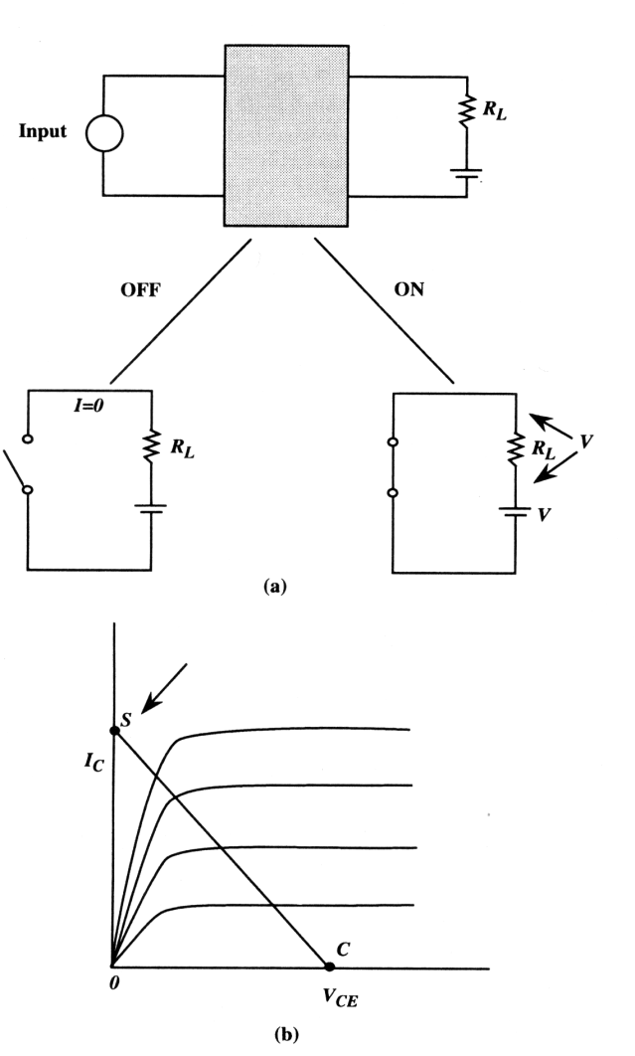
Bipolar Transistor: a switch ?
ON state: the switch is closed (saturation mode)
OFF state: the switch is open (cutoff mode)

Slide 38
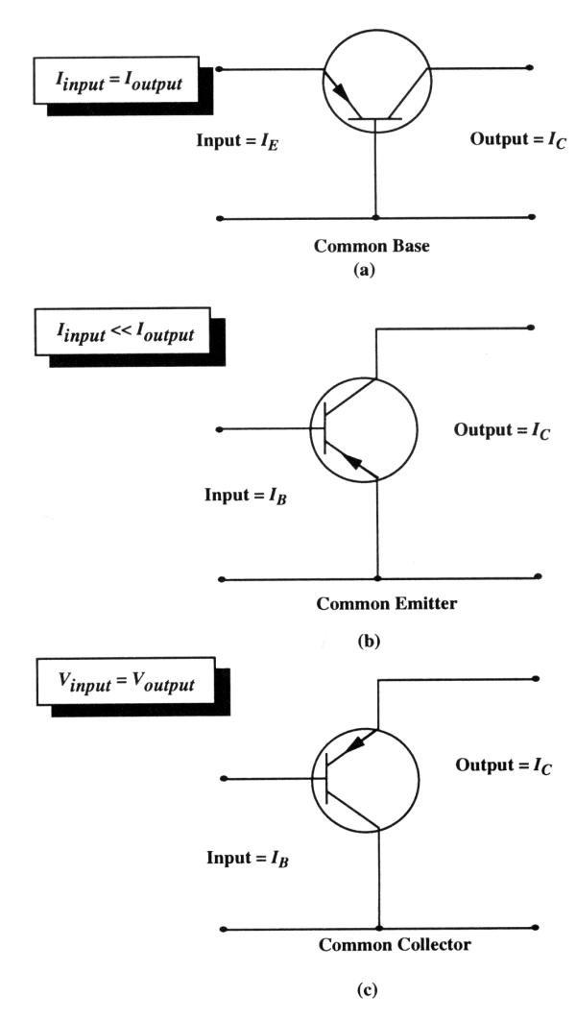
Bipolar Transistor: a switch ?
Input signal as low as possible
input power as low as possible
common emitter

Slide 39
Bipolar Transistor: a switch ?
Switching velocity?
Limiting factors?
Excess Base charge can be written:
Collector current is given by:
transit time
in the base (narrow)
Turn on transient:
  Continuity equation for the charge:

Slide 40
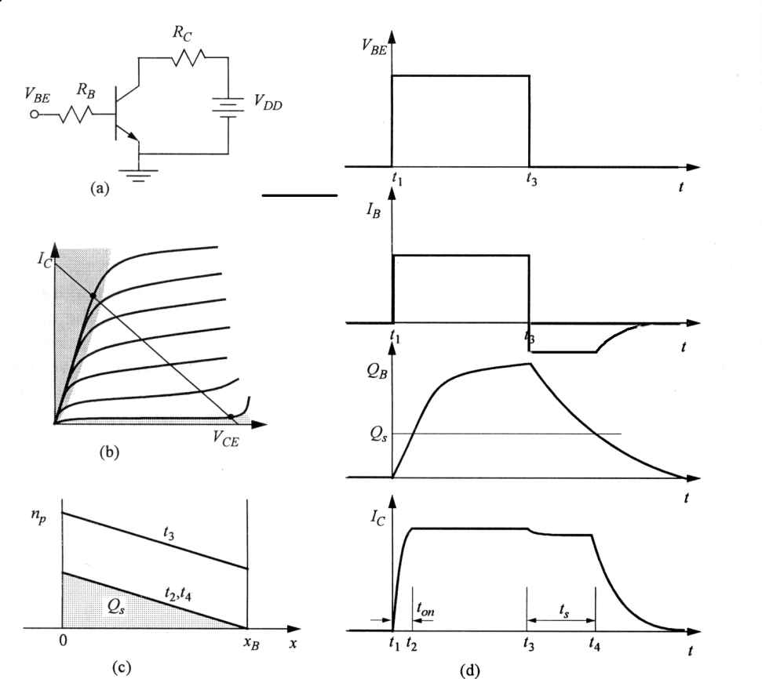
Bipolar Transistor: a switch ?
Turn on:
  I_{C} increases until the saturation regime is reached:
  (we neglect V_{CEsat})
  The limit charge Q_{B}(t_{on}) to saturate the transistor is given by :
  The on state time is given by:

Slide 41
Bipolar Transistor: a switch ?
Remark: the charge can increase over QB(ON) to over saturate the transistor.this charge is injected from the collector
Turn off time : input with a « 0 »:
  Evacuation of the stored charge
    This is the storage time t_{s}
    after, this is the same mechanism than for PN Junction
Final value:

Slide 42
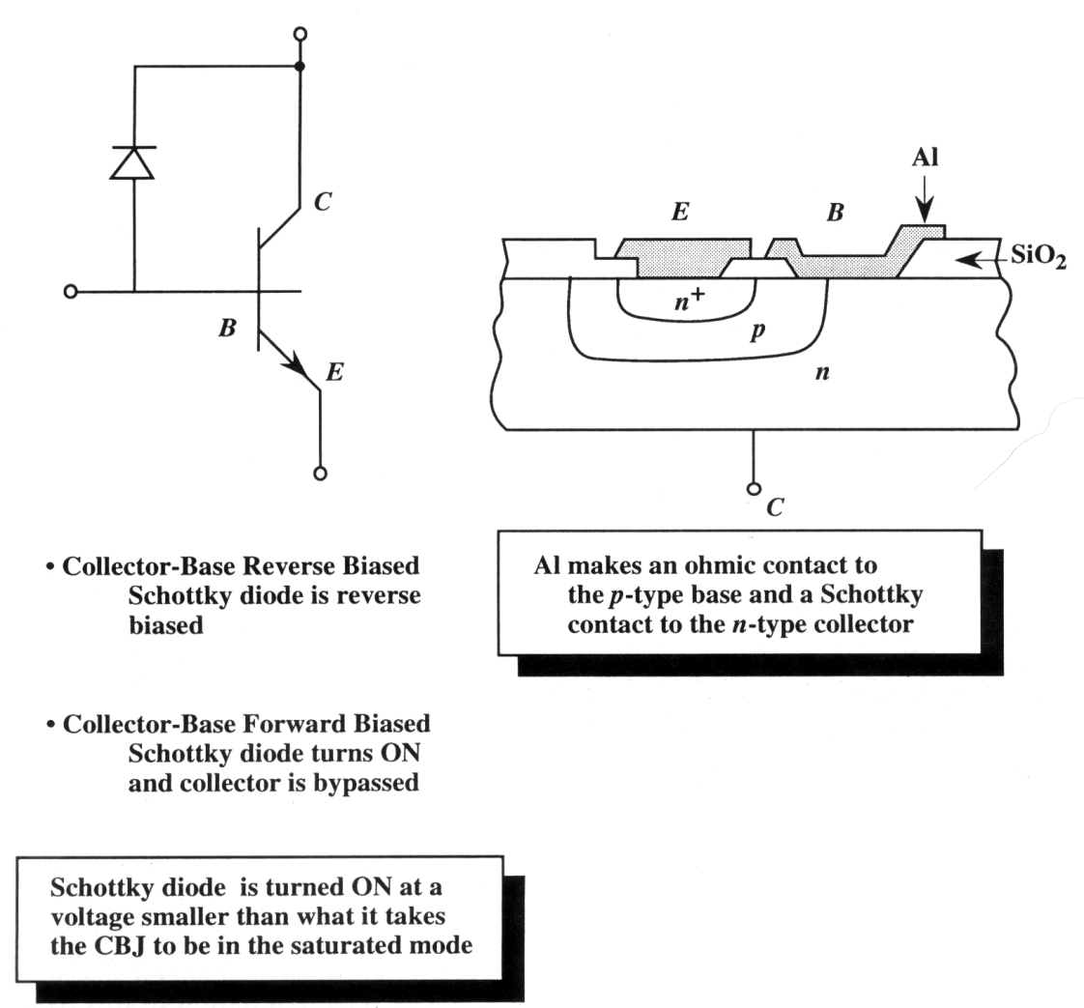
Bipolar Transistor: a switch ?
Storage time (desaturation) limits the switching time
2 ways to reduce it:
  Add impurities which decrease strongly the lifetime into the base (pb with transport factor)
  Schottky Diode in // with CB junction: avoid saturation of the transistor

Slide 43
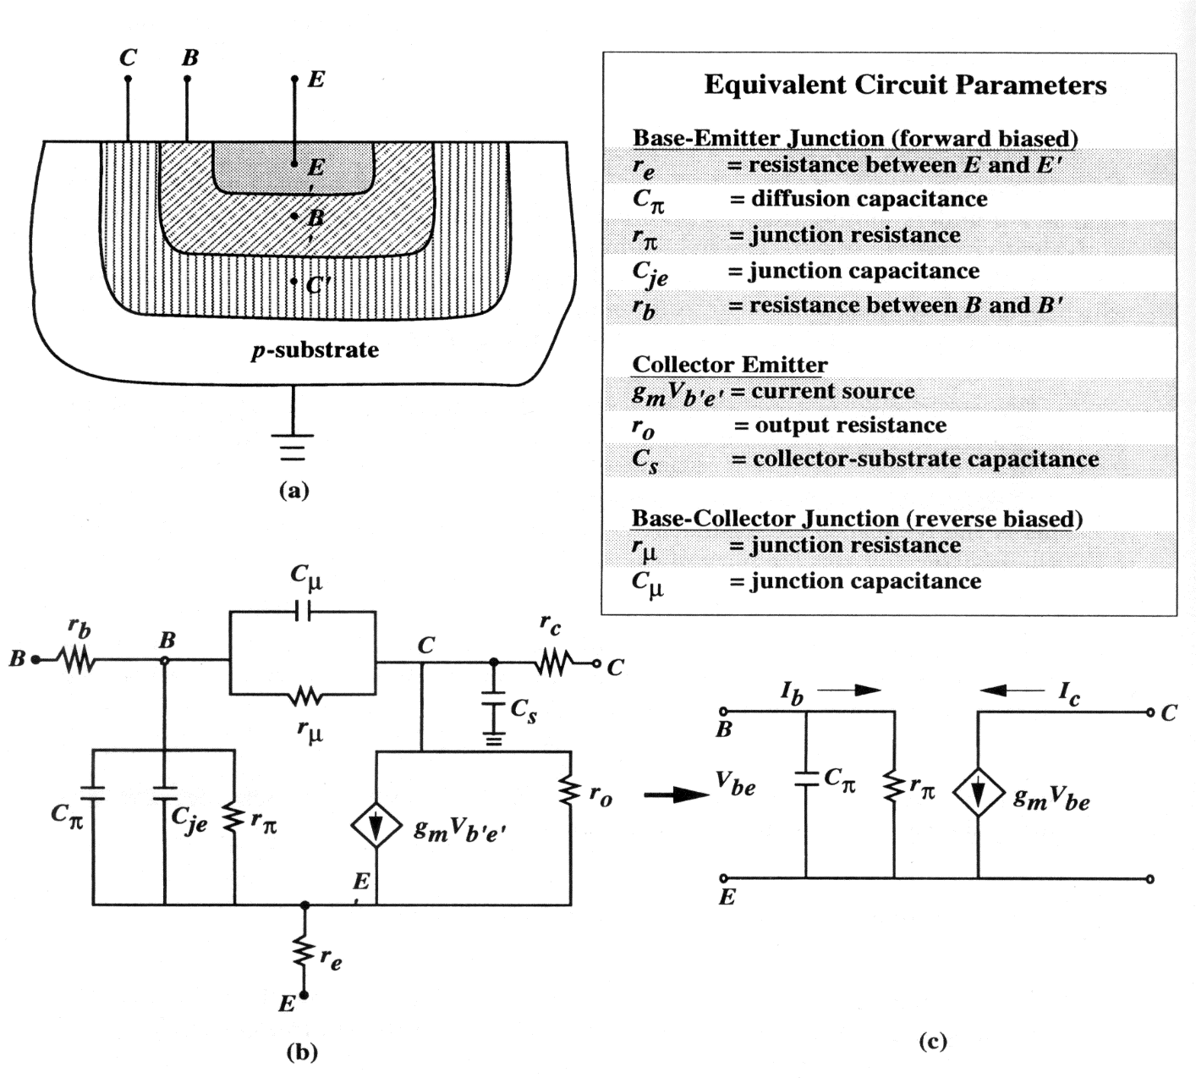
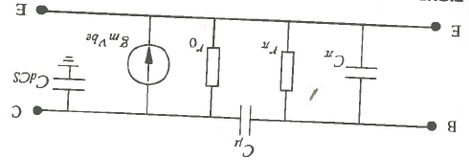
AC signal : equivalent circuit
I_{B}
Ib
C_{µ}
Ic

Slide 44
Transistor and ac signal: equivalent circuit
Transconductance :links the variation of the collector current to the base – emiter voltage:
Input resistance : links the variation of Base current to the base – emiter voltage:
Output resistance:

Slide 45
Transistor and ac signal: equivalent circuit
Capacitance :
  Storage capacitance
  transit time
Capacitance : CB junction capacitance reverse biased
Collector –substrate (depletion layer) capacitance:

Slide 46
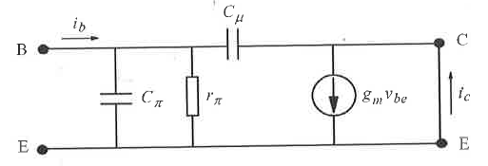
Transistor and ac signal: equivalent circuit
Cut off frequency (current gain =1 when load as a short circuit )
  We neglect (no Early Effect) r₀
Current gain is given by:

Slide 47
Transistor and ac signal: equivalent circuit
In modern devices , in general
At low frequency:
At high frequency, the imaginary term dominates and :

Slide 48
Transistor en ac: schéma équivalent
We get the « cutoff frequency » by considering i_{C}/i_{B}=1
By replacing all the terms by their expressions
Forward Transit time
Resistance neglected

Slide 49
Transistor en ac: schéma équivalent
Maximun oscillation frequency ⬄Power gain=1
  Laborious and tedious calculation/ we have to take into account the base resistance

Slide 50
Heterojunction Bipolar Transistor
Current gain:
In the case of narrow base:

Slide 51
Heterojunction Bipolar Transistor
If we want a gain β with a high value, we need α close to 1. It means:
  Lowering base doping
  Lowering base width (careful with punchthrough!)
Increase of the base resistance ⬄ f_{max} decreases

Slide 52
Heterojunction Bipolar Transistor
Other solution:
  Increase emitter doping
    Improve emitter efficiency
  Problem: « gap shrinking » ⬄
  This « problem » can be transform in opportunity !! (next two slides)

Slide 53
Heterojunction Bipolar Transistor
We see that it is difficult to have at the same time a large emitter doping, a lightly doped and thin base and a large gain

Slide 54
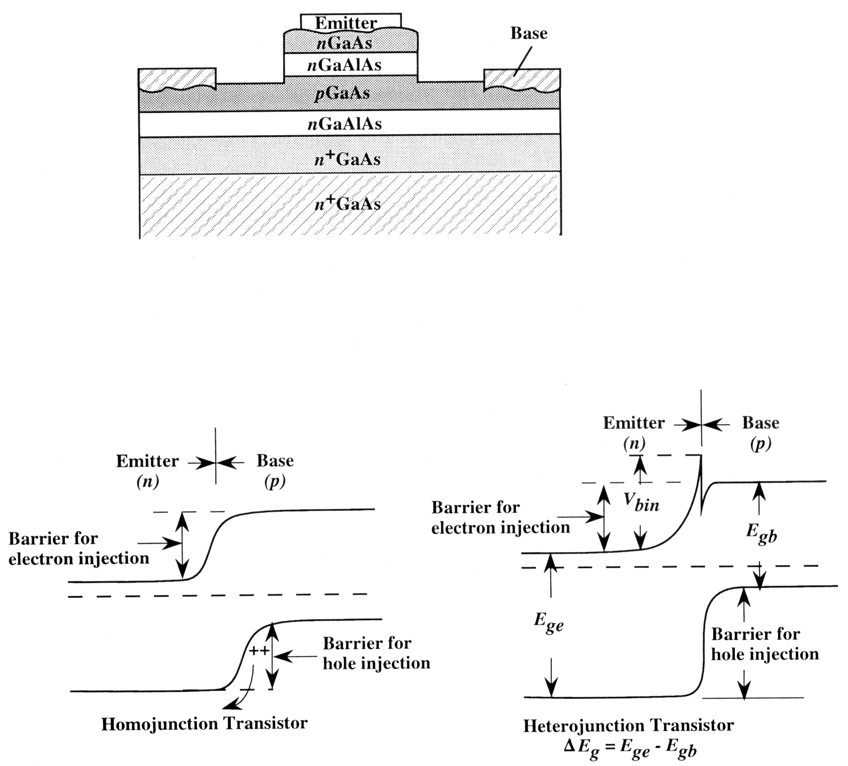
Heterojunction Bipolar Transistor
We design a structure with a negative energy gap difference: this is an HBT

Slide 55
Requirements for a bipolar device
    High gain
    High emitter efficiency
    High speed
(From Singh)
Demands and Problems for a BJT
Demands
Problems
Heavy emitter doping
Bandgap shrinkage causing base injection
Low base doping
Narrow base width
High base resistance
Solution: Heterojunction Bipolar Transistors
Emitter can be heavely doped using a SC with Eg larger than the base semiconductor
Base can be heavely doped and be made narrow without increasing base resistance
Collector can be chosen from a material to increase breakdown voltage

Slide 56
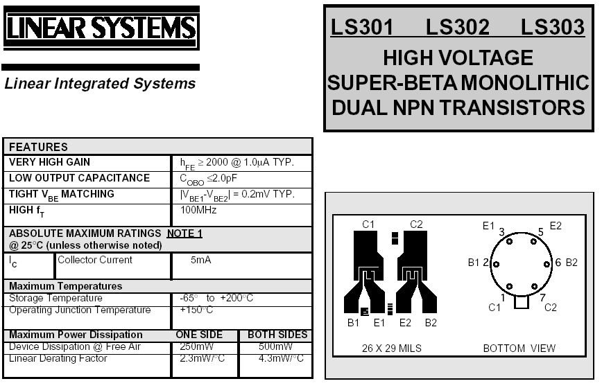

Slide 57
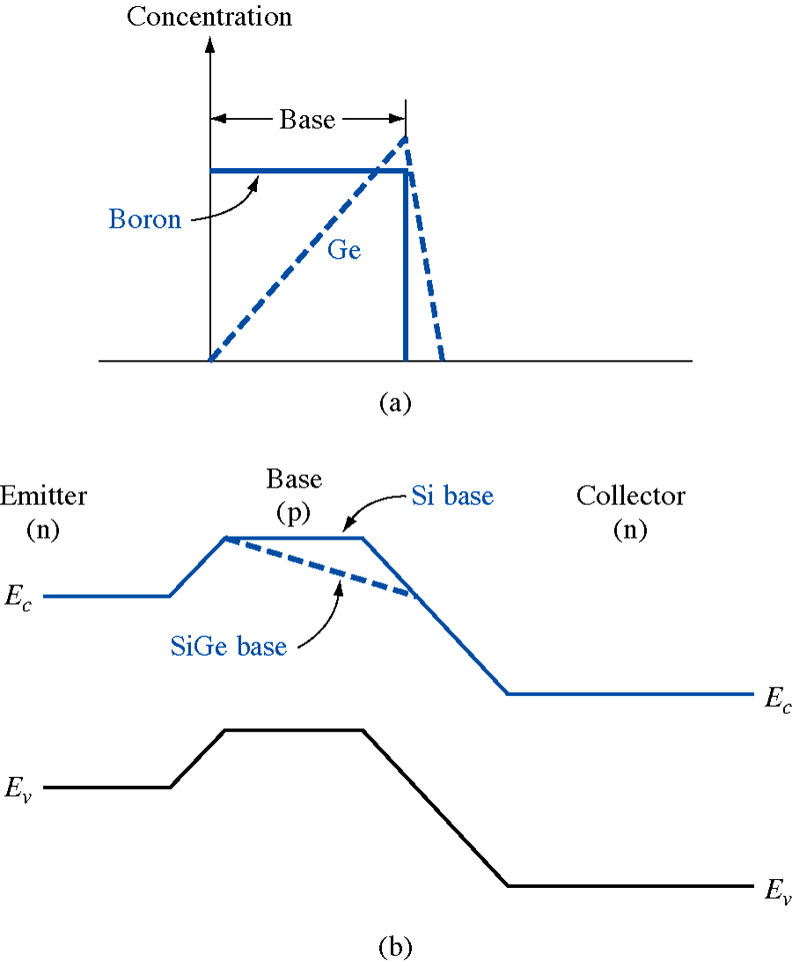
Transistor with a Silicon – Germanium base
Electrons density
base
emettir
collector
Improve gain
Improve transist time
Increase Early voltage

